Slide 1
Unite 9 : Bad times , good times

Slide 2
I wasn’t very well !

Slide 3
She wasn’t very well !

Slide 4
Headache

Slide 5
She has got a headache ☹

Slide 6
Stomach ache

Slide 7
He has got a stomach ache ☹

Slide 8
Toothache

Slide 9
I have got a headache ☹

Slide 10
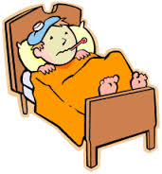
Fred : what’s the matter Yasser ?
Yasser : I ‘m not very well . I have got a headache . And I have got a stomach ache .And I have got a toothache.
Fred : oh, dear I’m sorry

Slide 11
Why is Yasser in the bed ?

Slide 13
Yesterday
Today
Tomorrow

Slide 14
………………………… was yesterday

Slide 15
……………….. Is today

Slide 16
………………… is tomorrow .

