Slide 1
8 What Did You Do Last Week?
1 Listen and Discuss
Did you do any of the things that Omar, Ahmed,
Saeed, and Imad did last week?
Next
Main Page
Previous

Slide 2
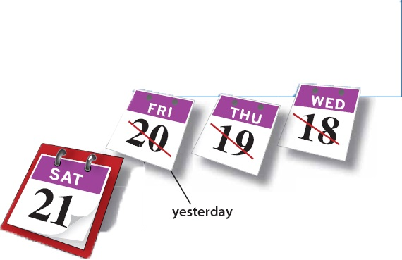
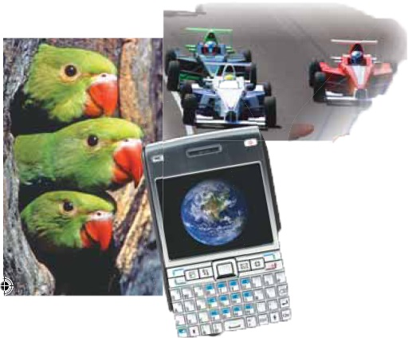
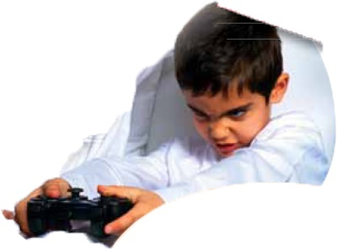
8 What Did You Do Last Week?
Next
Main Page
Previous

Slide 3
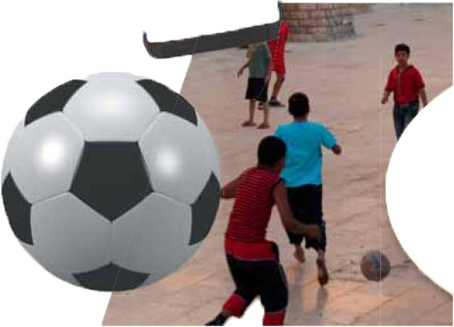
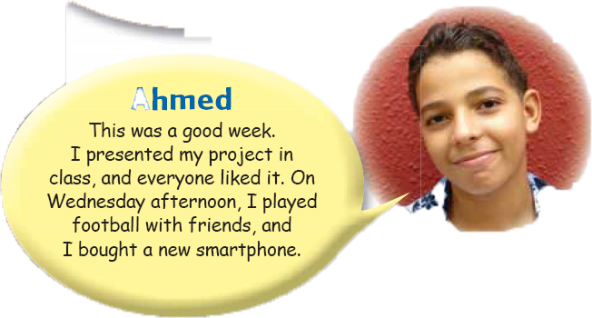
8 What Did You Do Last Week?
Next
Main Page
Previous

Slide 4
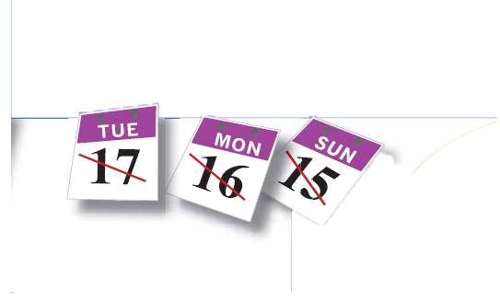
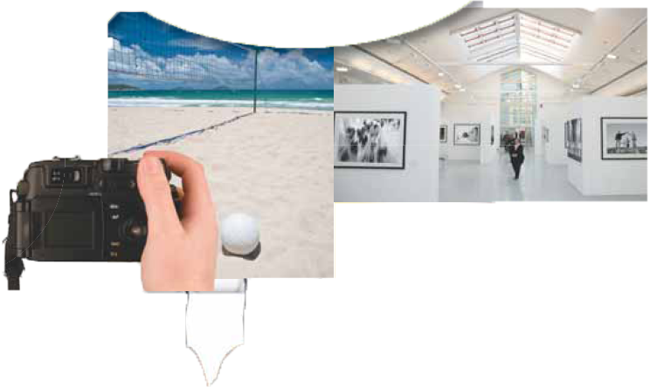
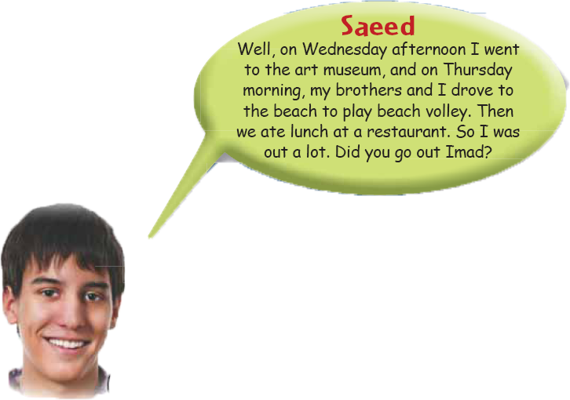
8 What Did You Do Last Week?
Next
Main Page
Previous

Slide 5
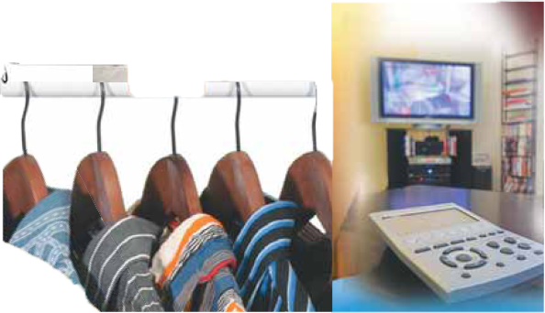
8 What Did You Do Last Week?
Next
Main Page
Previous

Slide 6
8 What Did You Do Last Week?
√ Quick Check
A. Vocabulary Read the explanations. Write a word from the descriptions
1. a competition with cars ________
2. equipment for video games ________
3. a high-tech phone ________
4. looking for ________
car race
console
smartphone
searching
Next
Main Page
Previous

Slide 7
8 What Did You Do Last Week?
B. Comprehension. Answer yes or no.
1. ___ Omar stayed at home on Thursday.
2. ___ Ahmed was pleased with his presentation.
3. ___ Saeed and his brothers drove to the museum.
4. ___ Imad needed to fi nish his assignment for Sunday.
no
yes
no
no
Next
Main Page
Previous

Slide 8
8 What Did You Do Last Week?
2 Pair Work
A. Ask and answer about the teens .
Did saeed go to school on Wednesday afternoon ?
No , he didn`t . He went to the art museum .
Did Imad stay home on Thursday
Yes , he did
Next
Main Page
Previous

Slide 9
8 What Did You Do Last Week?
B . Ask and answer about the teens yourself .
Did you have a test yesterday?
Yes, I did. / No, I didn’t.
What did you do yesterday afternoon?
I went to the zoo.
Next
Main Page
Previous

Slide 10
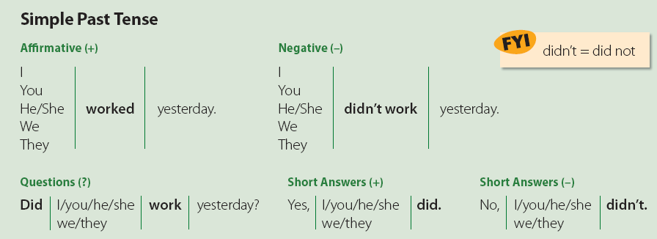
8 What Did You Do Last Week?
3 Grammar
Next
Main Page
Previous

Slide 11
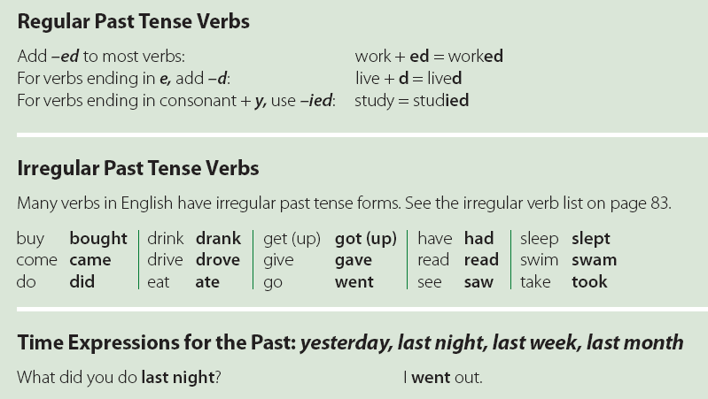
8 What Did You Do Last Week?
Next
Main Page
Previous

Slide 12
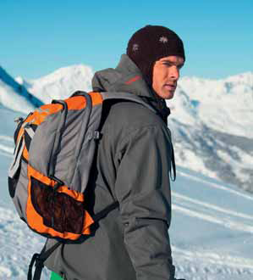
8 What Did You Do Last Week?
A. It was very cold last weekend, and there was snow. Which activities
do you think Steve did? Which activities didn’t he do? Use the list
of things. Add your own ideas.
√ He went skiing. He didn’t go swimming.
do the laundry watch DVDs
take a walk work outside in the garden
go to the mall talk on the phone
go to the baseball game eat cookies
read a book drink hot chocolate
Next
Main Page
Previous

Slide 13
8 What Did You Do Last Week?
He did the laundry. / He didn’t do the laundry.
He took a walk. / He didn’t take a walk.
He went to the mall. / He didn’t go to the mall.
He didn’t go to the baseball game.
He read a book. / He didn’t read a book.
He watched DVDs. / He didn’t watch DVDs.
He didn’t work outside in the garden.
He talked on the phone. / He didn’t talk on the phone.
He ate cookies. / He didn’t eat cookies.
He drank hot chocolate. / He didn’t drink hot chocolate
Next
Main Page
Previous

Slide 14
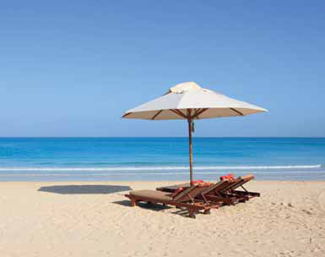
8 What Did You Do Last Week?
c. Work with a partner. Ask and answer about what the people did.
A: What did you do on your vacation?
B: I went to the beach.
you / on vacation
Next
Main Page
Previous

Slide 15
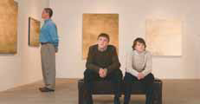
8 What Did You Do Last Week?
1. A: What did Badr and his brothers do last night?
B: They watched television / TV.
2 - Badr and his brothers / last night
2. A: What did your family do last weekend?
B: They went to the museum.
3 - your family / last weekend
Next
Main Page
Previous

Slide 16
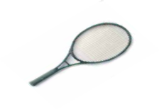
8 What Did You Do Last Week?
3. A: What did the boys do last Thursday?
B: They played tennis.
3 - the boys / last Thursday
4. A: What did Ron do last night?
B: He went to the library. / He read.
4 - Ron / last night
Next
Main Page
Previous

Slide 17
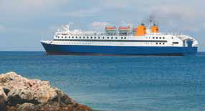
8 What Did You Do Last Week?
5. A: What did Keith and his family do in the summer?
B: The went on a cruise / to an island.
5 - Keith and his family / in the summer
6. A: What did Huda do before dinner?
B: She did her homework.
6 - Huda / before dinner
Next
Main Page
Previous

Slide 18
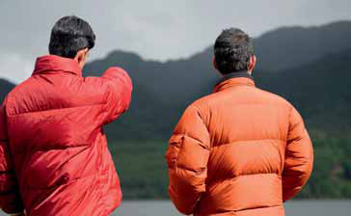
8 What Did You Do Last Week?
4 Listening
Listen to the conversation between the two friends . Answer the questions.
Next
Main Page
Previous

Slide 19
8 What Did You Do Last Week?
1. Who did Ken go out with?
2. Where did they go?
3. What did they talk about?
4. When did they go out?
5. Did Ken have a good time?
He went out with James.
They went to Gourmet’s, a restaurant near the lake.
They talked about James’s new car.
They went out on Wednesday night.
No, he didn’t.
Next
Main Page
Previous

Slide 20
8 What Did You Do Last Week?
5 Pronunciation
Listen to the pronunciation of the past tense endings. Then practice.
/t/ liked worked washed Paul worked in the morning.
/d/ played studied cleaned Alan studied French.
/Id/ wanted needed visited We needed some help.
Next
Main Page
Previous

Slide 21
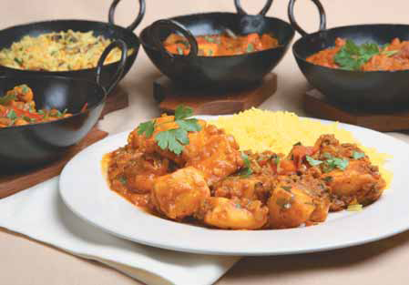
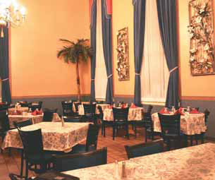
8 What Did You Do Last Week?
6 Conversation
Sam: What did you do last week?
Amr: Nothing special. How about you?
Sam: I went out with a new friend from work, Dave Robbins.
Amr: Really? What’s he like?
Sam: He’s very interesting but very demanding!
Amr: Where did you go?
Sam: Well, I wanted to impress him, so I took him to an expensive Indian restaurant.
Amr: Was the food good?
Sam: It was great. Um, the problem was he didn’t like the spicy food.
Amr: Didn’t you know?
Sam: No, he said he ate all kinds of foods. But at the Indian restaurant, he only had the rice!
Next
Main Page
Previous

Slide 22
8 What Did You Do Last Week?
About the Conversation
1. Who did Sam go out with?
2. What was he like?
3. Where did Sam take Dave?
4. What was the food like?
5. Did Dave like the food?
6. What did he eat?
He went out with a new friend, Dave Robbins.
He was interesting but demanding.
He took him to an Indian restaurant.
The food was great, but it was spicy.
No, he didn’t.
He only ate rice.
Next
Main Page
Previous

Slide 23
8 What Did You Do Last Week?
Your Turn
Ask your classmates about their activities last week.
A: Did you get up late on Thursday?
B: No, I didn’t.
Next
Main Page
Previous

Slide 24
8 What Did You Do Last Week?
7 About You
How good is your memory? Do you remember what you did recently?
1. Did you drink water with your dinner last night?
2. What did you eat for breakfast yesterday?
3. Who was the last person you talked to on the phone?
4. What was the last email you received?
5. When did you write an email to a friend? Who did you write to last?
6. When was the last time you visited relatives?
Next
Main Page
Previous

Slide 25
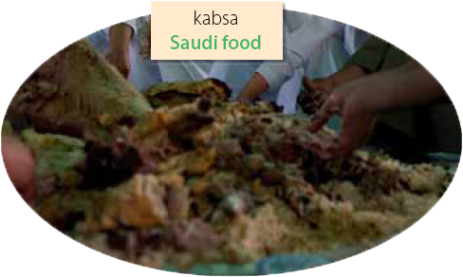
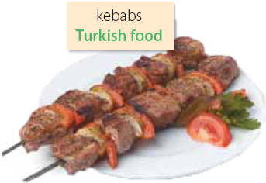
8 What Did You Do Last Week?
8 Reading
Before Reading
Do you like different kinds of ethnic dishes like sushi, pizza, and curry? Which do you like best?
Next
Main Page
Previous

Slide 26
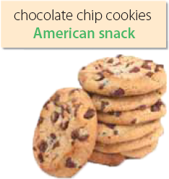
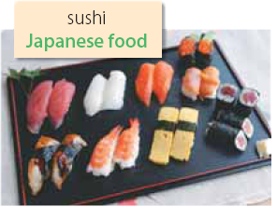
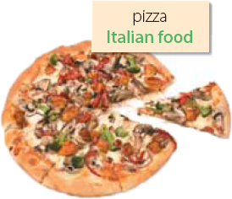
8 What Did You Do Last Week?
Many of the favorite foods and snacks in the world were accidents. For example, a favorite snack in the U.S. is chocolate chip cookies. In 1930, Mrs. Wakefield wanted to make cookies for her guests, but she didn’t have the baking chocolate that she usually used. She used regular chocolate, but it didn’t melt. It stayed in small pieces or chips. Her guests loved them, and chocolate chip cookies became popular everywhere.
Flat bread with diff rent toppings was common in many cultures, but it became famous in Naples, Italy when they added tomatoes and cheese. At first, it was a meal for the poor, but in the 1800s it became popular with kings and queens. Today, pizza is popular all around the world.
Next
Main Page
Previous

Slide 27
8 What Did You Do Last Week?
After Reading
Answer yes or no. Being cool means:
1. Who made the first chocolate chip cookies?
2. Why were chocolate chip cookies an “accident”?
3. Where did pizza become popular? Why?
4. What are some of the most popular dishes in the world?
5. What ethnic food is popular in your country?
Mrs. Wakefield made the first chocolate chip cookies.
Because they were created by mistake.
It became popular in Naples, Italy because they added tomatoes and cheese.
Next
Main Page
Previous

Slide 28
8 What Did You Do Last Week?
Discussion
Is it important to know about different ethnic cuisines? Why? Why not?
Next
Main Page
Previous

Slide 29
8 What Did You Do Last Week?
9 Writing
Write about your favorite food and how it is prepared. Include a list of the ingredients.
Next
Main Page
Previous

Slide 30
8 What Did You Do Last Week?
10 Project
Prepare a presentation about a regional dish
in your country.
Next
Main Page
Previous

