Slide 1
7 Then and Now
1 Listen and Discuss
How well do you know these cities?
What do you know about them?
Next
Main Page
Previous

Slide 2
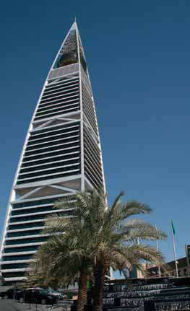
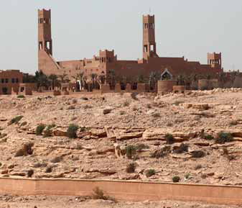
7 Then and Now
The old, oasis town of Riyadh was an area of about one square kilometer, with a population of about 14,000. There were many mud-brick houses, mosques, and other buildings inside the walls of the city.
Today, most of the buildings and walls of the old city are in ruins. But the Al-Masmak fort and some parts of the walls were restored and are in better condition. Nowadays, Riyadh is home to a population of almost 5.5 million people and covers an area of more than 1,500 square kilometers.Modern building complexes and skyscrapers like the Kingdom Center, the Al-Faisaliya Center, and the Riyadh TV Tower are now attractions of the new city.
Next
Main Page
Previous

Slide 3
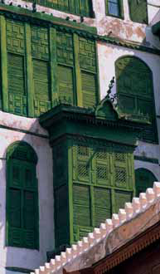
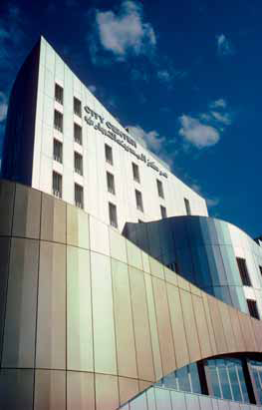
7 Then and Now
Balad, the old part of Jeddah,
was a group of three- to fivestory
buildings, with beautiful wooden balconies. The roads were narrow to protect pedestrians from the sun during the hot months and off ered
shelter from strong winds. All the woodwork was beautifully carved and decorated. There were plazas and souqs, where vendors from different places showed their products.Present day Jeddah is an
attractive, modern port city with tall buildings, beautiful homes, and a wide range of stores and hotels.
Next
Main Page
Previous

Slide 4
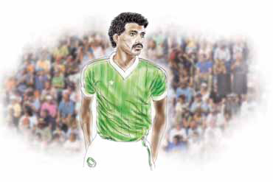
7 Then and Now
Majed Ahmed Abdullah is the best football striker
in the history of Saudi Arabia. He is also the all-time
goal leader of the Saudi national team. He was born
in Jeddah, but moved to Riyadh with his family when
he was very young. Majed’s father was a football
manager.
Majed and his friends used to play for a club called
Al-Nasser while he was still in high school. They were
too young to join a football tournament, but their team was finally accepted after a 3-1 win in a game against an important Riyadh team.
Majed holds two national records: one when he scored 5 goals in an international game against the national team of Qatar in 1979; and another one when he scored 4 goals against India, during the 1984 Summer Olympics.
Next
Main Page
Previous

Slide 5
7 Then and Now
√ Quick Check
A. Vocabulary. Mark the information about the buildings, materials, and size of each city.
Next
Main Page
Previous

Slide 6
7 Then and Now
B. Comprehension. Answer yes or no.
1. _______ The walls of the old city of Riyadh were made of concrete.
2. _______ Most of the buildings in Balad had two stories.
3. _______ More than 5 million people live in Riyadh.
4. _______ The Al-Masmak fort is in ruins.
5. _______ Majed was a member of the Saudi national team.
no
no
yes
no
yes
Next
Main Page
Previous

Slide 7
7 Then and Now
2 Pair Work
A. Ask and answer about the cities and Majed.
What was the population in old Riyadh?
It was about 14,000 people.
Was Majed in Jeddah when he was a teenager?
No, he wasn’t. He was in Riyadh.
Next
Main Page
Previous

Slide 8
7 Then and Now
B. Ask and answer about yourself .
Where were you born?
I was born in _______.
Next
Main Page
Previous

Slide 9
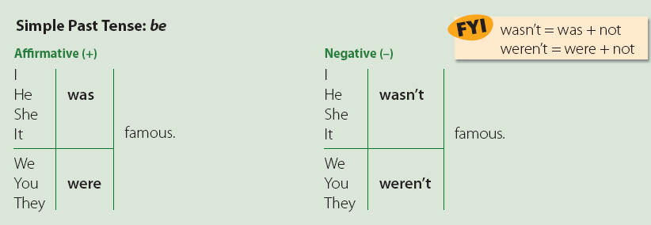
7 Then and Now
3 Grammar
Next
Main Page
Previous

Slide 10
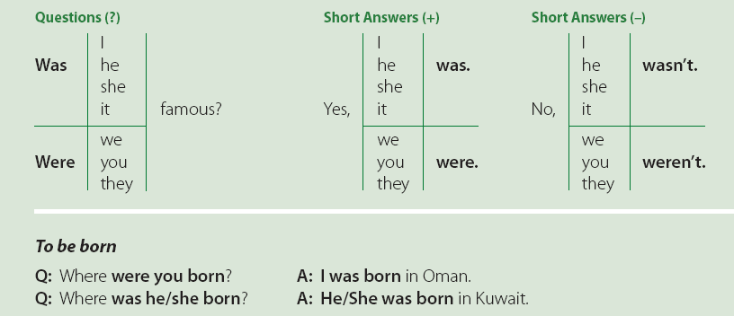
7 Then and Now
Next
Main Page
Previous

Slide 11
7 Then and Now
A. Complete the conversations. Use was/wasn’t or were/weren’t. .
1. A: ______ your father born in the States?
B: No, he ______. He ______ born in Europe.
A: Where in Europe ______ he born?
B: He ______ born in Poland.
was
wasn’t
was
was
was
was
2. A: What ______ your father’s first job?
B: He and his brother ______ waiters.
A: How old ______ they?
B: They ______ very old —17 and 15.
were
were
weren’t
Next
Main Page
Previous

Slide 12
7 Then and Now
was
3. A: How ______ the graduation party?
B: It ______ great.
A: Who ______ there?
B: All our friends ______ there.
was
was
were
was
4. A: What ______ Oscar like?
B: He ______ very smart.
A: ______ his grades good?
B: No, they ______.
was
were
weren’t
Next
Main Page
Previous

Slide 13
7 Then and Now
5. A: ______ you late for school?
B: Yes, I ______.
A: Why?
B: The bus ______ late.
were
was
was
was
6. A: ______ the hotel comfortable?
B: Yes, it ______ OK.
A: What ______ the weather like?
B: It ______ terrible.
was
was
was
Next
Main Page
Previous

Slide 14
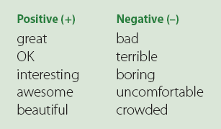
7 Then and Now
B. Work with a partner. Imagine you went on vacation to these places. Ask and answer about your vacation. Use the adjectives in the box.
A: How was your vacation?
B: It was great. OR It was boring.
A: That’s good! OR That’s too bad!
Next
Main Page
Previous

Slide 15
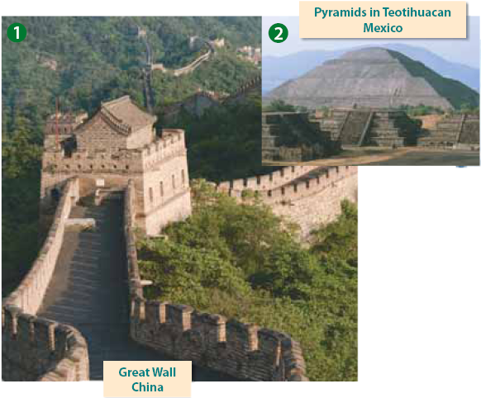
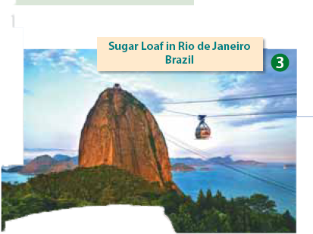
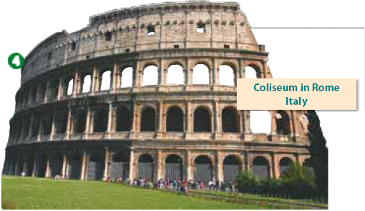
7 Then and Now
Next
Main Page
Previous

Slide 16
7 Then and Now
4 Listening
Listen to the description of the life of Majed Ahmed Abdullah. Complete the information.
Arabian Pelé | 1. Nickname
Al-Jazaeria Elementary School, Al-Motawasta Al-Thania High School | 2. Schools
goalkeeper for his school and neighborhood team, formed a team with his friends when he was in high school | 3. Football experience before Al-Nasser
two | 4. National records
Under 17 National Team in 1977, Senior National Team in 1978 for 16 year | 5. National Team
Next
Main Page
Previous

Slide 17
7 Then and Now
5 Pronunciation
Listen to the pronunciation of was and were. Then practice.
You were late for class. Where were you?
Sorry I was late. I was in the library.
Next
Main Page
Previous

Slide 18
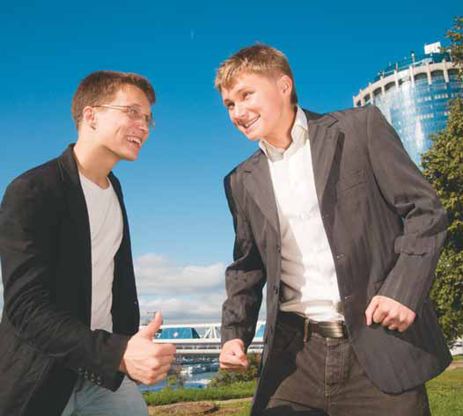
7 Then and Now
6 Conversation
Neil: Hi, Leo. Don’t you remember me? Neil Roberts. I was in your class in ninth grade.
Leo: Oh, yeah. Sure, I remember you. How are things?
Neil: OK. Do you ever see any of our old classmates?
Leo: Not very often. How about you?
Neil: From time to time. Remember Keith Anderson? He was always the winner of school competitions. He is a management consultant now.
Leo: Really? What about Derek Adams? He was really smart
Neil: Yes, he was. Now he’s a successful businessman, and . . . my boss.
Leo: You’re kidding!
Next
Main Page
Previous

Slide 19
7 Then and Now
About the Conversation
1. Were Leo and Neil in the same class? What grade?
2. Does Leo see his old classmates often?
3. What was Keith Anderson like?
4. What does Derek Adams do now?
Yes, they were. It was in ninth grade.
No, he doesn’t.
He was always the winner of school competitions.
He is a successful businessman and Neil’s boss.
Next
Main Page
Previous

Slide 20
7 Then and Now
Your Turn
Role-play the conversation. Imagine you meet an old school friend. Discuss classmates, teachers, and events.
Next
Main Page
Previous

Slide 21
7 Then and Now
7 About You
1. Were your grades good in elementary school?
2. What was your favorite subject?
3. What was your favorite after-school activity?
4. Who was your favorite teacher?
5. Who was your best friend?
6. Where is he/she now? What is he/she doing?
Next
Main Page
Previous

Slide 22
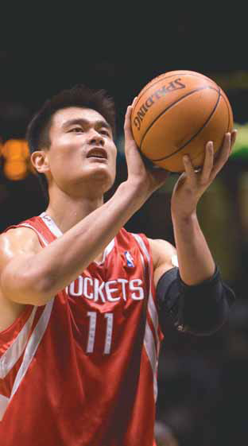
7 Then and Now
8 Reading
Before Reading
What do you know about basketball? What do you know about the person in the picture?
Next
Main Page
Previous

Slide 23
7 Then and Now
In China, his nickname is “Little Giant.” In the West, they call him the “Great Wall.” Yao Ming is 7 feet 6 inches (2.29 meters) tall. He was born on September 12, 1980, in Shanghai, China. His parents were both tall. Their beds were extra long, and their clothes and shoes were in special large sizes. His dad was a successful basketball player.
Yao wasn’t interested in basketball as a child. He was tall but very thin, and he wasn’t very strong. Yao’s parents were very encouraging, and by the age of 12, he was serious about basketball. His progress at Shanghai’s sports academy was excellent. Soon he was on his local youth team. Yao’s big chance to play for the Chinese national team was in 1999 in the Asian Cup. By 2002, he was a member of the Houston Rockets, one of the top professional teams in the U.S. At the opening ceremony of the Olympic Games in Beijing in 2008, he was the flag carrier for the entire Chinese team and a member of the basketball team.
Yao Ming is a celebrity, and his smiling face appears in commercials around the world. He has fans everywhere. In his free time, Yao likes to go home to China and enjoy his mom’s cooking. He says he misses hanging out with his friends at home and playing video games.
Next
Main Page
Previous

Slide 24
7 Then and Now
After Reading
1. Where was Yao Ming born?
2. Were his parents short?
3. When was Yao first serious about basketball?
4. What was the name of his team in the U.S.?
5. What does he like to do in his free time?
Shanghai, China
No, they were tall.
By the age of twelve.
The Houston Rockets
He likes to go home to China and enjoy his mom’s cooking.
Next
Main Page
Previous

Slide 25
7 Then and Now
9 Writing
Write about a celebrity in your country.
Next
Main Page
Previous

Slide 26
7 Then and Now
10 Project
Work in pairs. Choose a famous person. Find information about the person. Create an interview one of you is the famous person, and the other is the interviewer. Present it to the class.
Next
Main Page
Previous

