Slide 1
5 What Are You Going To Wear There?
1 Listen and Discuss
What kind of clothes do you like to wear?
Next
Main Page
Previous

Slide 2
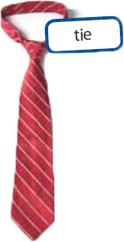
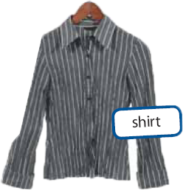
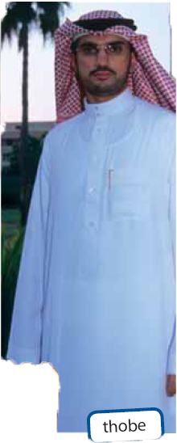
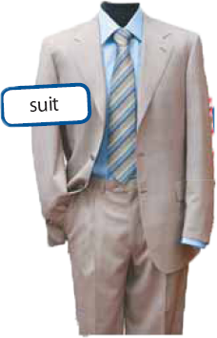
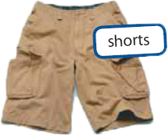
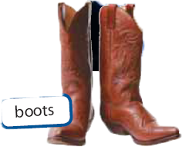
5 What Are You Going To Wear There?
Next
Main Page
Previous

Slide 3
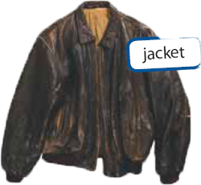
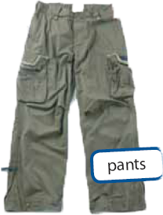
5 What Are You Going To Wear There?
Next
Main Page
Previous

Slide 4
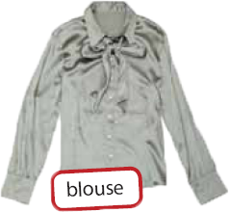
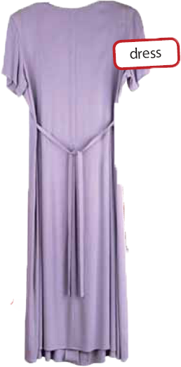
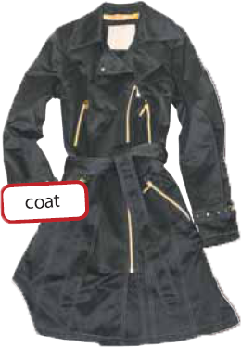
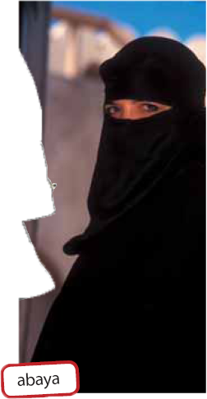
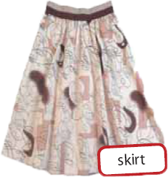
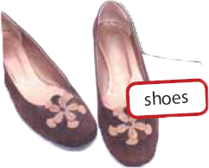
5 What Are You Going To Wear There?
Next
Main Page
Previous

Slide 5
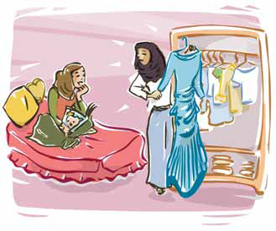
5 What Are You Going To Wear There?
Nawal : I`m going to a wedding on the weekend . I don`t know what to wear .
Sabah : me too . I`m going to go shopping for a formal dress . Do you want to come with me ?
Next
Main Page
Previous

Slide 6
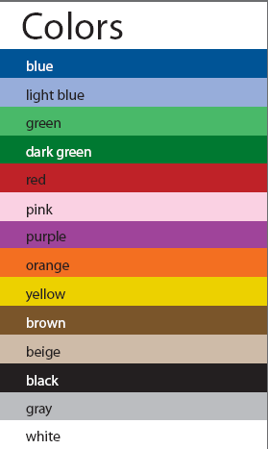
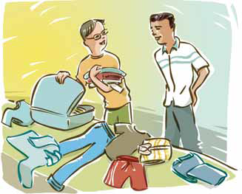
5 What Are You Going To Wear There?
Steve : I`m going to travel to Rio de Janeiro on vacation what clothes do I need
Mario : I think you`re going to need casual clothes for the hot weather : T-shirt , jeans , shorts , and a hat !
Next
Main Page
Previous

Slide 7
5 What Are You Going To Wear There?
√ Quick Check
A. Vocabulary. List the clothes you are wearing today. Also give the colors.
Next
Main Page
Previous

Slide 8
5 What Are You Going To Wear There?
B. Comprehension. Answer yes or no.
1. ___ Steve is going to Rio de Janeiro for work.
2. ___ He’s going to need casual clothes.
3. ___ Nawal is going to get married next weekend.
4. ___ Sabah is going to buy an abaya.
no
yes
no
no
Next
Main Page
Previous

Slide 9
5 What Are You Going To Wear There?
2 Pair Work
A. Ask and answer
What clothes do I need to buy for Abha in the winter?
You need warm clothes. It’s cold in Abha.
What clothes do I need for Turkey in July?
You need light clothes. The weather is very hot.
Next
Main Page
Previous

Slide 10
5 What Are You Going To Wear There?
What are you going to do next weekend?
I’m going to go shopping.
What color are your boots?
They’re brown.
Next
Main Page
Previous

Slide 11
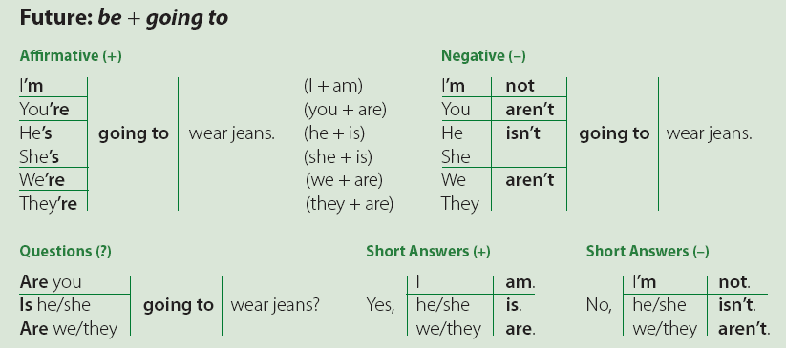
5 What Are You Going To Wear There?
3 Grammar
Next
Main Page
Previous

Slide 12
5 What Are You Going To Wear There?
Next
Main Page
Previous

Slide 13
5 What Are You Going To Wear There?
A. Unscramble the sentences.
1. She / going / a new dress / is / to buy ___________________________________
2. jeans / are / to the park / They / to wear / going ___________________________________
3. a new pair of sneakers / to shop for / going / I’m ___________________________________
4. to wear / sandals / is / to the beach / He / going ___________________________________
5. are / for Dad / We / going / a tie / to buy ___________________________________
6. to need / going / for work / are / a suit / You ___________________________________
She is going to buy a new dress.
They are going to wear jeans to the park.
I’m going to shop for a new pair of sneakers.
He is going to wear sandals to the beach.
We are going to buy a tie for Dad.
You are going to need a suit for work.
Next
Main Page
Previous

Slide 14
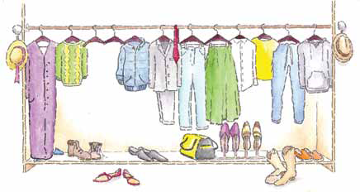
5 What Are You Going To Wear There?
B. Work in a group. Ask and answer.
Next
Main Page
Previous

Slide 15
5 What Are You Going To Wear There?
B. Work in a group. Ask and answer.
A: What do you usually wear on a plane?
B: I usually wear a T-shirt and jeans.
1. at home
2. to school
3. to a football game
4. to the beach
5. in cold weather
6. in hot weather
7. Your idea: ______
Next
Main Page
Previous

Slide 16
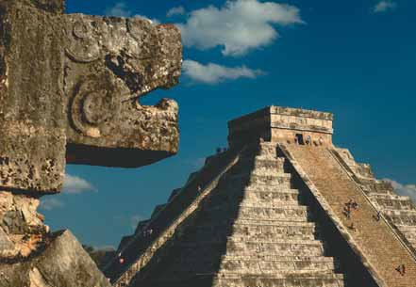
5 What Are You Going To Wear There?
c. Work with a partner. Ask and answer.
A: Where is Bob going to go on vacation?
B: He’s going to go to Mexico.
A: What’s he going to take?
B: He’s going to take shorts and T-shirts.
Next
Main Page
Previous

Slide 17
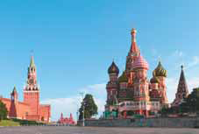
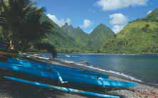
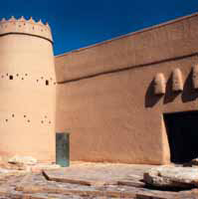
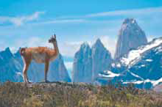
5 What Are You Going To Wear There?
Tom and Sam / Moscow
Mel / Tahiti
Hussain / Saudi Arabia
George and Joe / the Andes
Next
Main Page
Previous

Slide 18
5 What Are You Going To Wear There?
4 Listening
What are Adnan and Mark going to buy? Listen and complete the chart.
Write all the colors you hear each person say.
Style | Colors | Clothes
 |  |  | 1. Adnan
 |  |  | 2. Mark
coat, boots
blue or black, brown
casual
dark gray or dark
blue, white or blue
suit, shirt, tie
formal
Next
Main Page
Previous

Slide 19
5 What Are You Going To Wear There?
5 Pronunciation
Listen to the pronunciation of going to. Notice how the two words are pronounced together. Then practice.
What are you going to do? I’m going to meet my friends.
What are you going to wear? I’m going to wear a sweater and jeans.
Next
Main Page
Previous

Slide 20
5 What Are You Going To Wear There?
6 Writing
1. Choose a classmate, and write a description of the person’s clothes.
2. Read the description to the class. Ask, “Who is it?”
Next
Main Page
Previous

Slide 21
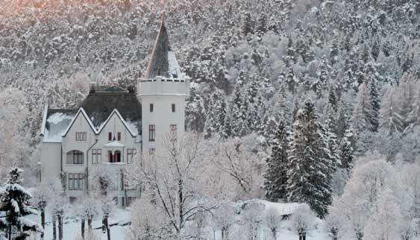
5 What Are You Going To Wear There?
7 Conversation
Brian: What clothes are you going to take to Norway?
Andy: Warm clothes, very warm clothes. You know, a heavy coat, a scarf, gloves …
I’m going to pack all my sweaters and warm socks.
Brian: Don’t forget your sunglasses!
Josh: He’s not going to need sunglasses. He isn’t going to the beach.
Andy: Actually, Brian is right. I’m going to put them on when I’m out in the snow!
Josh: You, out in the cold? You must be joking ….
Next
Main Page
Previous

Slide 22
5 What Are You Going To Wear There?
About the Conversation
1. Where is Andy going to go?
2. What is he going to wear?
Andy is going to go to Norway.
He’s going to wear warm clothes. He’s going to wear a heavy
coat, a scarf, gloves, sweaters, warm socks, and sunglasses.
Next
Main Page
Previous

Slide 23
5 What Are You Going To Wear There?
Your Turn
Someone is going to visit Riyadh.
Tell them what clothes to take.
Next
Main Page
Previous

Slide 24
5 What Are You Going To Wear There?
8 About You
1. What kind of clothes do you like wearing? Casual or formal?
2. What’s your favorite color for clothes?
3. Do you like shopping for clothes? Why? Why not?
4. What clothes do you need to buy?
5. Where do you shop for clothes?
6. Are clothes expensive in your country?
7. What are you going to wear to school tomorrow?
8. Do you think clothes tell a lot about your personality?
Next
Main Page
Previous

Slide 25
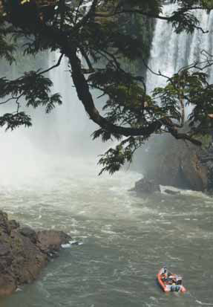
5 What Are You Going To Wear There?
9 Reading
Before Reading
Look at the photos. What do you think the reading is about?
The Iguassu Falls are on the border of Brazil and Argentina. They are very beautiful and very famous. The falls are very popular with tourists from all around the world.
At some times during the year, you can see as many as 275 separate waterfalls. The waterfalls go a distance of 2,700 meters. You can hear the roaring sound of the water several kilometers away.
Visitors wear waterproof jackets or raincoats with hoods to keep their heads dry. They also wear rubber boots or waterproof shoes.
Next
Main Page
Previous

Slide 26
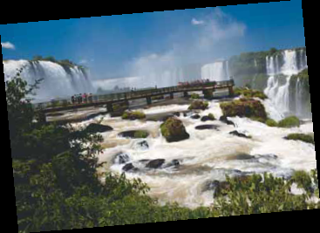
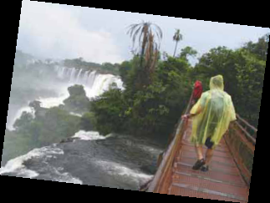
5 What Are You Going To Wear There?
Transportation:
There are buses to the falls at the Iguassu Park.
Towns:
The town of Foz do Iguassu is near the falls. It’s a big town, and it’s very busy with people from many places around the world.
Other Attractions:
• Makuku boat ride on the Iguassu River to the falls. Very exciting!
• Helicopter ride over the falls. Great fun!
• Itaipu Dam (hydroelectric dam).
• Walk on the Brazilian side for a great view.
Next
Main Page
Previous

Slide 27
5 What Are You Going To Wear There?
After Reading
1. What is so beautiful about calligraphy?
2. Why did the Prophet Mohammed, peace be upon him, need a clear system of writing?
3. How is Kufic script different from cursive scripts?
4. Where can you see examples of Thuluth script?
The Iguassu Falls are on the border of Brazil and Argentina.
The town of Foz do Iguassu is near the falls.
An exciting boat ride on the Iguassu River, a helicopter ride over
the falls, the Itaipu Dam (hydroelectric dam), a walk with a great view of the falls
People go to the falls by bus.
Visitors wear waterproof jackets or raincoats with hoods and
rubber boots or waterproof shoes.
Next
Main Page
Previous

Slide 28
5 What Are You Going To Wear There?
10 Project
In groups, discuss who your shopping advisors are. Find out from your classmates who is most important in their clothing choices.
Present your survey results to the class.
____ Advertising ____ Salespeople _____ Fashion magazines
___ Manufacturer/store websites ___ Family and friends ___ Other
Next
Main Page
Previous

