Slide 1
3 What Time Do You Get Up?
1 Listen and Discuss
Which activities are the same or different in
your country at these times?
Next
Main Page
Previous

Slide 2
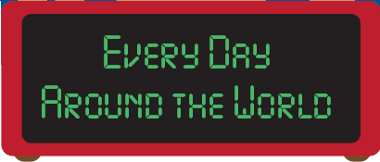
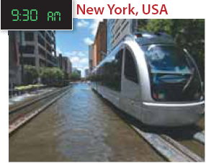
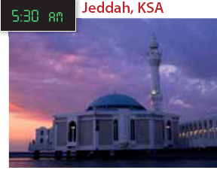
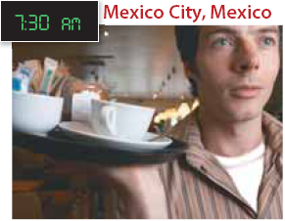
3 What Time Do You Get Up?
Jeff and Rick always take the train to work. Traffic is bad in the morning, so they never drive to work.
Amal is waking up.
She usually gets up early
in the morning.
Alex in working. He usually serves breakfast in the morning.
Next
Main Page
Previous

Slide 3
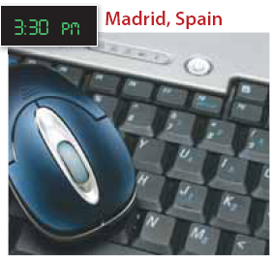
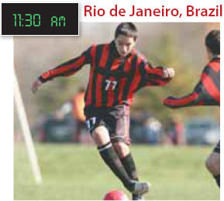
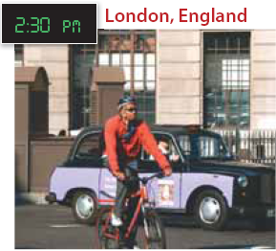
3 What Time Do You Get Up?
Fernando is at work. He
always checks his email
after lunch.
Bob is riding home from
work. He usually goes to
work by bike.
Fernando is at work. He
always checks his email
after lunch.
Next
Main Page
Previous

Slide 4
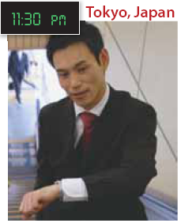
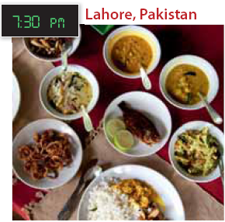
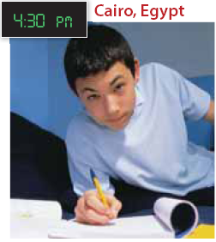
3 What Time Do You Get Up?
Takeshi is going back home. He is a lawyer and he usually works late.
Mr. Zaheer Abbas and his family are eating. They always have dinner together.
Ali is doing his homework. He usually studies before dinner.
Next
Main Page
Previous

Slide 5
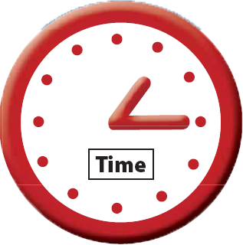
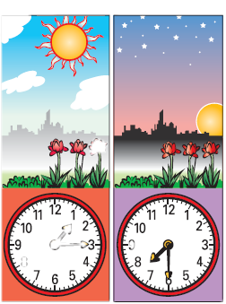
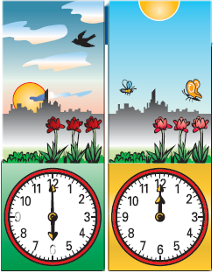
3 What Time Do You Get Up?
It’s one fifteen in the afternoon.
It’s 1:15 P.M.
It’s seven thirty in the evening.
It’s 7:30 P.M.
It’s six o’clock in the morning. It’s 6:00 A.M.
It’s noon.
It’s 12:00 (noon).
Next
Main Page
Previous

Slide 6
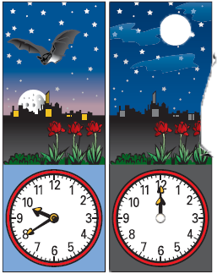
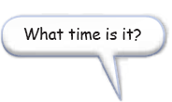
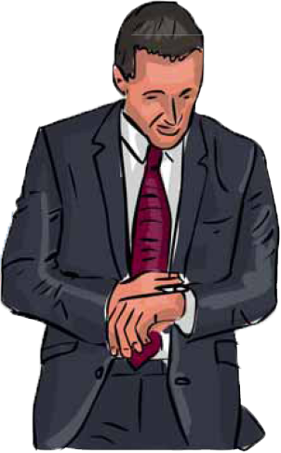
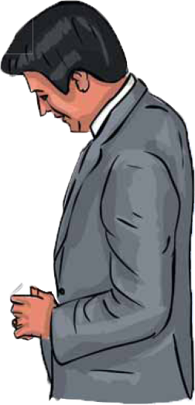
3 What Time Do You Get Up?
It’s one fifteen in the afternoon.
It’s 1:15 P.M.
It’s seven thirty in the evening.
It’s 7:30 P.M.
Next
Main Page
Previous

Slide 7
3 What Time Do You Get Up?
√ Quick Check
A. Vocabulary. What activities on page 14 do you do every day? Write them in order from morning to night..
Next
Main Page
Previous

Slide 8
3 What Time Do You Get Up?
B. Comprehension. Answer yes or no.
1. ___ Amal usually gets up early.
2. ___ Alex is having breakfast.
3. ___ Jeff and Rick never drive to work.
4. ___ Celso plays football at school.
5. ___ Bob goes to work by bus.
6. ___ Fernando reads his email in the offi ce.
7. ___ Ali usually studies after dinner.
8. ___ Takeshi usually goes home early.
yes
no
yes
yes
no
yes
no
no
Next
Main Page
Previous

Slide 9
3 What Time Do You Get Up?
2 Pair Work
A. Ask and answer : about the people on page 14.
What time does Amal usually get up?
She usually gets up at fi ve thirty.
Next
Main Page
Previous

Slide 10
3 What Time Do You Get Up?
B. Ask and answer about daily activities .
What do you usually do after dinner?
I usually watch TV.
Next
Main Page
Previous

Slide 11
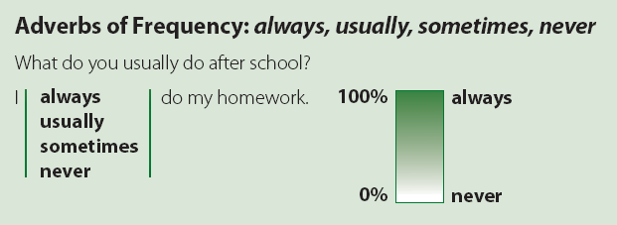
3 What Time Do You Get Up?
3 Grammar
Next
Main Page
Previous

Slide 12
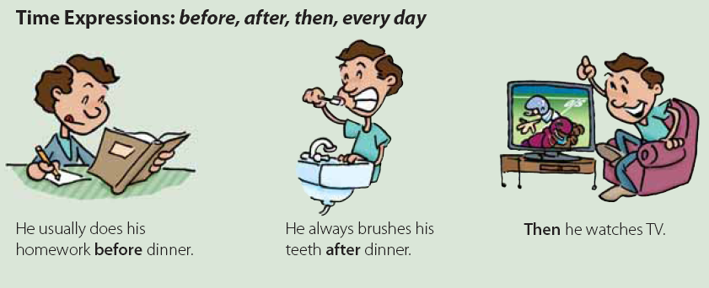
3 What Time Do You Get Up?
Next
Main Page
Previous

Slide 13
3 What Time Do You Get Up?
Next
Main Page
Previous

Slide 14
3 What Time Do You Get Up?
A. Unscramble the sentences.
√ in the morning / usually / at seven o’clock / get up / I
1. opens / at nine / usually / The bank
2. closes / The supermarket / on Sundays / never
3. to work / drive / always / My brothers
4. in our family / go to bed late / The children / never
5. always / in the afternoon / do / I / my homework
6. usually / eats dinner / My family / at six
I usually get up in the morning at seven o`clock
The bank opens usually at nine
The supermarket never closes on Sundays.
My brothers always drive to work.
The children in our family never go to bed late.
I always do my homework in the afternoon.
My family usually eats dinner at six.
Next
Main Page
Previous

Slide 15
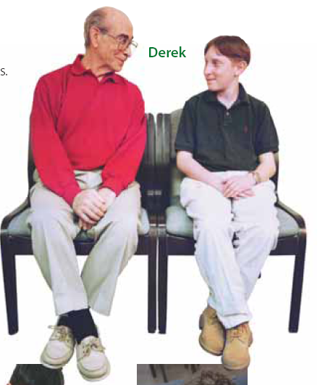
3 What Time Do You Get Up?
B. Work with a partner. Talk about the people’s daily activities.
usually / weekends
Derek usually visits his grandfather on weekends.
Next
Main Page
Previous

Slide 16
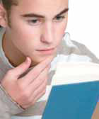
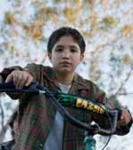
3 What Time Do You Get Up?
1- Alan
always / the evening
Alan always studies in the evening.
2- Tariq
sometimes / the morning
Tariq sometimes cycles in the morning.
Next
Main Page
Previous

Slide 17
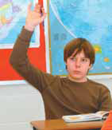
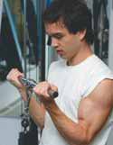
3 What Time Do You Get Up?
3- Adam
never / weekends
Adam never goes to school on weekends.
4- Leo
usually / Saturdays
Leo usually exercises on Saturdays.
Next
Main Page
Previous

Slide 18
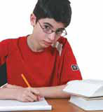
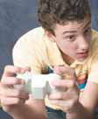
3 What Time Do You Get Up?
5 - Khalid
always / after school
Khalid always does his homework after school.
6 - Steve
sometimes / the evening
Steve sometimes plays video games in the evening.
Next
Main Page
Previous

Slide 19
3 What Time Do You Get Up?
C. Look at the activities in exercise B, and write sentences about yourself. Use adverbs of frequency. Share them with a partner
Look at the activities in exercise B, and write sentences about yourself. Use adverbs of frequency. Share them with a partner.
Next
Main Page
Previous

Slide 20
3 What Time Do You Get Up?
4 Listening
Listen to Jeff ’s typical day. Tick ( √ ) the things he does.
1. ___ Jeff usually exercises before breakfast.
2. ___ He rides the bus to school.
3. ___ He does his homework after practice.
4. ___ Jeff plays tennis on weekends.
5. ___ He never meets his friends on weeknights.
Next
Main Page
Previous

Slide 21
3 What Time Do You Get Up?
5 Pronunciation
Listen. Listen to the pronunciation of Does he and Does she. Notice how the words are pronounced together. Then practice.
Does she get up early?
Does he exercise every day?
Next
Main Page
Previous

Slide 22
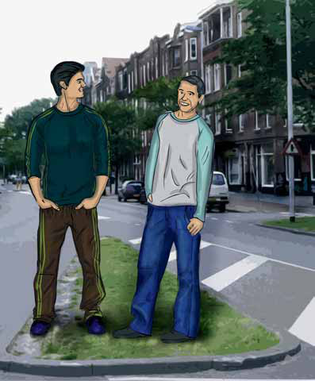
3 What Time Do You Get Up?
6 Conversation
Fahd: Hi, Ryan. Where are you going?
Ryan: To the gym. I usually work out for about an hour in the afternoon. Where are you off to?
Fahd: To martial arts class.
Ryan: That’s awesome! What are you
learning?
Fahd: Well, right now, I’m learning some difficult karate moves. But sometimes we do special exercises to learn how to concentrate. Come along some time.
Next
Main Page
Previous

Slide 23
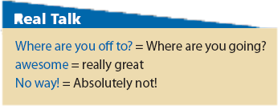
3 What Time Do You Get Up?
Next
Main Page
Previous

Slide 24
3 What Time Do You Get Up?
About the Conversation
1. What does Ryan usually do in the afternoons?
2. What kind of lesson does Fahd have?
3. What is he learning now?
He usually works out for about an hour.
He has a karate lesson. / He has a martial arts class.
He’s learning some difficult karate moves.
Next
Main Page
Previous

Slide 25
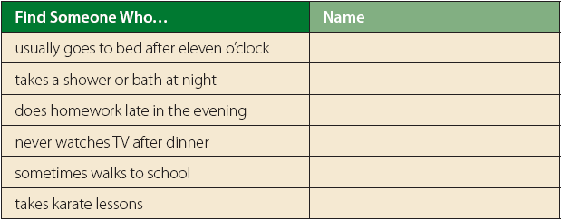
3 What Time Do You Get Up?
Your Turn
Find someone in your class who does each of the activities.
Next
Main Page
Previous

Slide 26
3 What Time Do You Get Up?
7 About You
1. Do you take any lessons? What kind?
2. What do you usually do on Thursdays?
3. What do you never do on Thursdays?
Next
Main Page
Previous

Slide 27
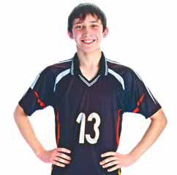
3 What Time Do You Get Up?
8 Reading
Before Reading
Do you have a school newspaper or web page? What information does it have?
Next
Main Page
Previous

Slide 28
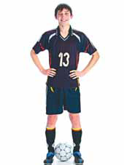
3 What Time Do You Get Up?
Ahmed
Jeddah, Saudi Arabia
I usually arrive at school before 8 A.M. Assembly is at 8, and we always sing the Saudi national anthem. After assembly, we go straight to the classroom. We have six classes a day. Each one lasts 45 minutes. We only leave our classroom for subjects like computer, PE, and art. School fi nishes at 2:45 P.M.,
but there is an optional seventh period for students who want extra tutoring. There are after-school clubs. I’m a member of the football club, so I sometimes stay after school and play football..
Next
Main Page
Previous

Slide 29
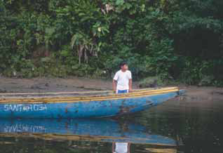
3 What Time Do You Get Up?
My school is in a village on the Aguarico River. I live far from the school, so I need to get up at 5 A.M. I go to school by canoe, but when it rains a lot I stay at home. Our school has 46 students and two classrooms. There are two teachers, one for grades 1–3, the other for grades 4–6. We study all the subjects in Quechua, our first language, but we also learn Spanish. Our school has a generator for electricity, and it has a computer.
Next
Main Page
Previous

Slide 30
3 What Time Do You Get Up?
After Reading
Underline or list the things and activities that are different from your school. Compare with a partner.
Next
Main Page
Previous

Slide 31
3 What Time Do You Get Up?
9 Writing
Write about a typical day at your school.
Next
Main Page
Previous

Slide 32
3 What Time Do You Get Up?
10 Project
Work in a group. Research routines of schools around
the world. Write how they are like or diff erent
from your school.
Next
Main Page
Previous

