Slide 1
2 What’s School Like?
1 Listen and Discuss
Choose an adjective from the box to describe eachschool subject. Compare your choices in a group.
Next
Main Page
Previous

Slide 2
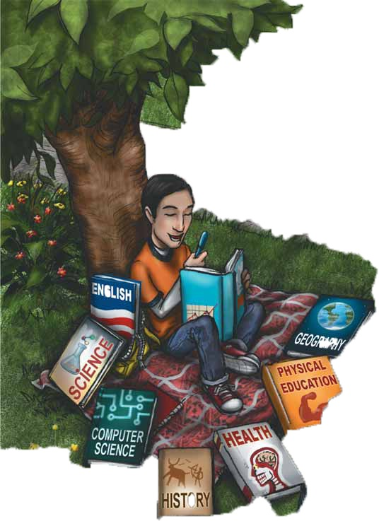
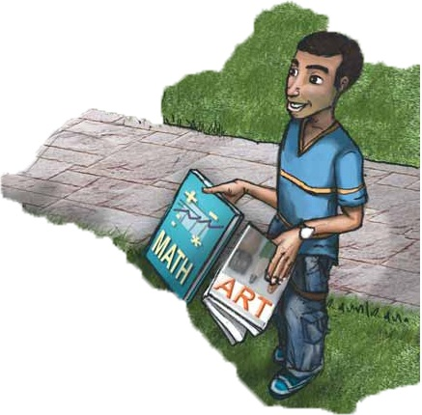
2 What’s School Like?
What`s your favorite subject , carl ?
History . It`s interesting . Do you like history
No , I don`t . There are too many names and dates .
Next
Main Page
Previous

Slide 3
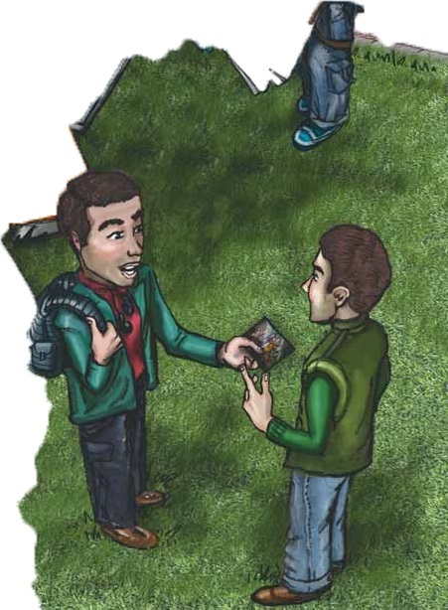
2 What’s School Like?
Who are your friends in school ?
Well , there`s Ben
What does Ben look like ?
He`s tall and athletic. Wait , here`s a picture of my school friends .
Next
Main Page
Previous

Slide 4
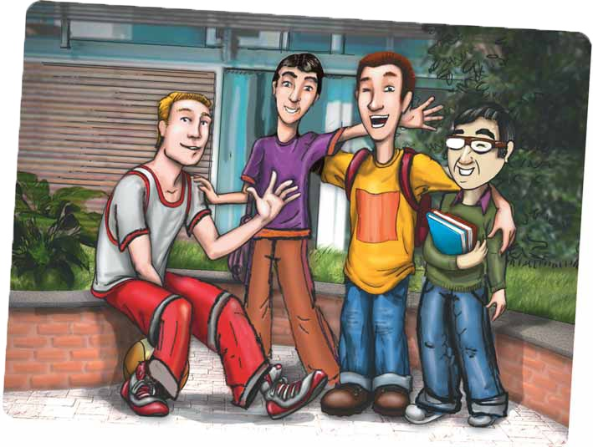
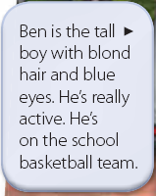
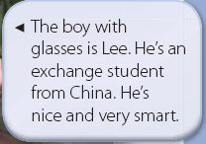
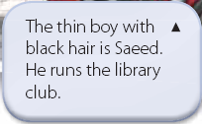
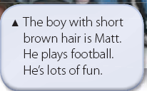
2 What’s School Like?
Next
Main Page
Previous

Slide 5
2 What’s School Like?
√ Quick Check
A. Vocabulary Match the words.
1. ___ active a. difficult
2. ___ interesting b. athletic
3. ___ smart c. not boring
4. ___ hard d. intelligent
b
d
c
a
Next
Main Page
Previous

Slide 6
2 What’s School Like?
B. Comprehension Answer yes or no.
1. ___ Carl’s favorite subject is history.
2. ___ Ben plays on the volleyball team.
3. ___ Saeed runs the computer club.
4. ___ Matt has curly blond hair.
5. ___ Lee wears glasses.
yes
no
no
no
yes
Next
Main Page
Previous

Slide 7
2 What’s School Like?
2 Pair Work
A. Ask and answer. About school subjects.
Do you like math?
Yes, I do. It’s great.
I think it’s difficult.
Next
Main Page
Previous

Slide 8
2 What’s School Like?
B. Ask and answer . About the classmates in the picture above.
Does Matt have blond hair?
No, he doesn’t.
Does he play football?
Yes, he does.
Next
Main Page
Previous

Slide 9
2 What’s School Like?
3 Grammar
Next
Main Page
Previous

Slide 10
2 What’s School Like?
Next
Main Page
Previous

Slide 11
2 What’s School Like?
A. Answer the questions about Ahmed’s schedule..
1. Does Ahmed take Spanish?
2. Does he have French on Saturday?
3. Does Mr. Dobbs teach history?
4. Do Mr. Fat’hi and Mr. Al-Jahawi teach science?
No, he doesn’t. He takes French.
Yes, he does.
No, he doesn’t. He teaches math.
Yes, they do.
Next
Main Page
Previous

Slide 12
2 What’s School Like?
A. Answer the questions about Ahmed’s schedule..
5. What subject does Ahmed have last on Monday?
6. What subject does he have three times a week?
7. What subjects does he have every day?
8. What does Mr. Al-Halawi teach?
He has science last on Wednesday.
He has French three times a week.
He has English, math, and science every day.
He teaches history.
Next
Main Page
Previous

Slide 13
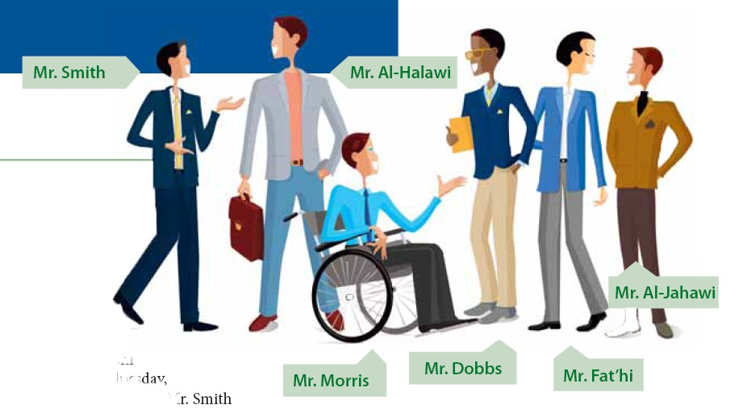
2 What’s School Like?
B. Look at the picture. Ahmed is writing about his schedule and his teachers. Complete his description.
Next
Main Page
Previous

Slide 14
2 What’s School Like?
I have classes from Saturday to Wednesday, and I have six teachers. Mr. Smith (1) ______ English. He has (2) ______ ______ hair and blue eyes. He gives a lot of homework. Mr. Al-Halawi is the history teacher. He’s (3) ______ , and he has (4) ______ hair. Mr. Dobbs teaches math. He always (5) ______ a jacket and tie, and he’s a very good teacher. Mr. Fat’hi and Mr. Al-Jahawi (6) ______ science. Mr. Fat’hi has short (7) ______ hair. Mr. Al-Jahawi is short, and he has (8) ______ brown hair. They are very strict. French is my favorite subject, and Mr. Morris is our teacher. He has (9) ______ ______ hair and blue eyes, and he’s a lot of fun. We (10) ______ French in class, and I send emails to my friends in Canada in French.
teaches
short black
tall
tall
brown
wears
teach
black
short
short
brown
speak
Next
Main Page
Previous

Slide 15
2 What’s School Like?
4 Listening
You are meeting two visitors at the airport. You don’t know what they look like. Listen to the descriptions. Answer yes or no.
Ted Seth
1. ______ Ted has black hair. 1. ______ Seth has brown hair.
2. ______ Ted has long hair. 2. ______ Seth wears glasses.
3. ______ Ted is tall. 3. ______ Seth is short.
4. ______ Ted is carrying . 4. ______ Seth always carries a a laptop camera .
no
no
no
no
yes
yes
yes
yes
Next
Main Page
Previous

Slide 16
2 What’s School Like?
5 Pronunciation
Listen to the -es endings of the words. Then practice.
Mr. Robinson teaches geography. The description matches the photo.
Kerry watches TV every night. Fred uses the library all the time.
Next
Main Page
Previous

Slide 17
2 What’s School Like?
6 Writing
1. Choose a classmate, and write a description of the person.
2. Read the description to the class. Ask, “Who is it?”
Next
Main Page
Previous

Slide 18
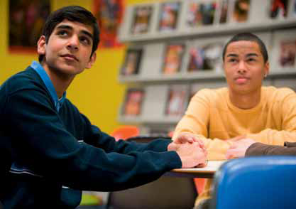
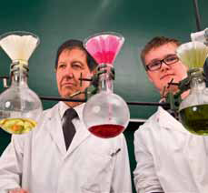
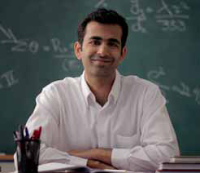
2 What’s School Like?
7 Conversation
Jim: What’s your favorite subject?
Faris: I like science. I think it’s cool. I love the experiments.
Jim: I prefer history. It’s fascinating. What areyour teachers like this year?
Faris: They’re OK. But I don’t like the math teacher. He’s very strict, and he gives a lot of tests. How about you?
Jim: I like Mr. Huston, the English teacher
Next
Main Page
Previous

Slide 19
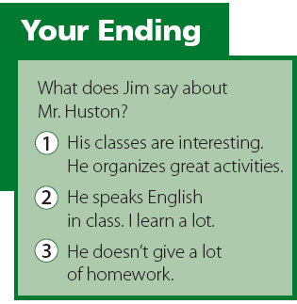
2 What’s School Like?
Next
Main Page
Previous

Slide 20
2 What’s School Like?
About the Conversation
1. What’s Faris’s favorite subject? Why?
2. Does Jim like history? Why?
3. Does Faris like the math teacher? Why not?
4. Who is Jim’s favorite teacher?
Faris’s favorite subject is science. Faris loves the experiments.
Yes, he does. He thinks it’s fascinating.
No, he doesn’t. The teacher is very strict, and he gives a lot of tests
No, he doesn’t. The teacher is very strict, and he gives a lot of tests
Next
Main Page
Previous

Slide 21
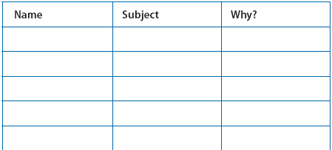
2 What’s School Like?
Your Turn
Work in a group. Ask your classmates about their favorite
subjects. Compare your answers with other groups.
A: What’s your favorite subject?
B: ______
A: Why?
B: ______
Next
Main Page
Previous

Slide 22
2 What’s School Like?
8 About You
1. Do you have lots of homework?
2. What’s your school schedule like?
3. Who’s your best friend at school?
4. What does he/she look like?
Next
Main Page
Previous

Slide 23
2 What’s School Like?
8 Reading
Before Reading
What clubs does your school have?
Next
Main Page
Previous

Slide 24
2 What’s School Like?
The Science Club: Students organize their own experiments. Club members are students
who say: “I’m sort of like a scientist too,” and “Science is cool.” Do you feel the same?
Archaeology Club: Students learn how to excavate archaeological fi ndings. Club members organize expeditions in the desert every spring.
Poetry Club: Students learn and recite traditional and modern poetry. They write poetry and organize poetry readings.
Computer Club: Members learn about and get a chance to use lots of computer programs—from spreadsheets to games. Some students even design their own programs.Does this interest you?
Drama Club: Members learn the basics of acting and get a chance to act in plays in front of student audiences. Get on stage and get in on the act.
Football Club: Members practice and compete for the school team. They also help with the organization of football games with other school teams.
Next
Main Page
Previous

Slide 25
2 What’s School Like?
After Reading
Write the club in which students do each of the activities.
1. word processing ___________
2. acting ___________
3. visit archaeological sites ___________
4. present poetry ___________
5. play for the school team ___________
6. use chemicals ___________
computer club
drama club
archaeology club
poetry club
football club
science club
Next
Main Page
Previous

Slide 26
2 What’s School Like?
10 Project
In a group, write an advertisement for a school club. Present it to the class.
Next
Main Page
Previous

