Slide 1
1 What Do You Do?
1 Listen and Discuss
Look at the information about the boys.
What do they want to be?
Next
Main Page
Previous

Slide 2
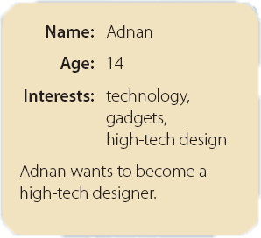
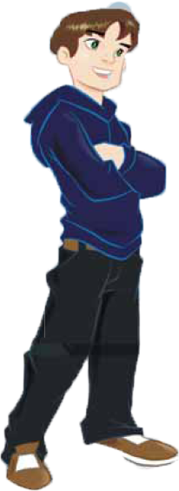
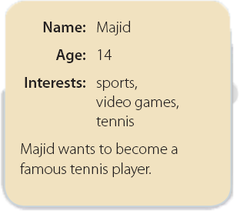
1 What Do You Do?
Next
Main Page
Previous

Slide 3
1 What Do You Do?
Next
Main Page
Previous

Slide 4
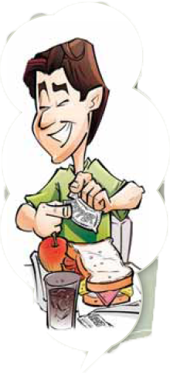
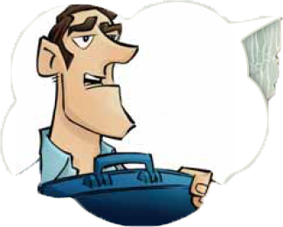
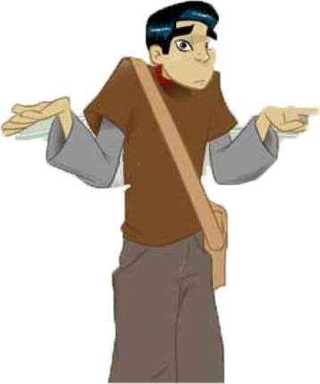
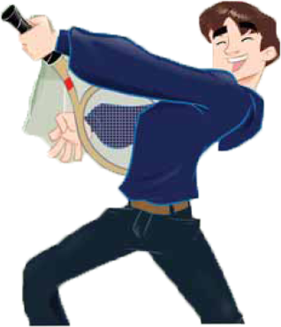
1 What Do You Do?
Next
Main Page
Previous

Slide 5
1 What Do You Do?
Adnan : So you want to become a tennis player?
Majid : Yes, very much.
Adnan : And what does your father do?
Majid : He’s a doctor, but he likes to cook. He
makes the best sandwiches! What about you? What do you want to be?
Adnan : I want to be a designer. You know, I want to design gadgets, computers, and things
Majid : And what about your father? What does he do?
Adnan : He’s a mechanic. But he always carries a briefcase, and people think he’s a lawyer!
Next
Main Page
Previous

Slide 6
1 What Do You Do?
√ Quick Check
A. Vocabulary. What’s the name of the job?
. 1. plays tennis
. 2. works in a hospital
3. teaches at a school
4. designs new gadgets
tennis player
nurse / doctor
teacher
high-tech designer
Next
Main Page
Previous

Slide 7
1 What Do You Do?
B. Comprehension. Answer yes or no.
1. ___ Majid wants to be a teacher.
2. ___ Adnan wants to be a designer.
3. ___ Majid designs games.
4. ___ Adnan is interested in technology.
no
no
yes
yes
Next
Main Page
Previous

Slide 8
1 What Do You Do?
2 Pair Work
A. Ask and answer about the people
What does Majid do?
He’s a student. He goes to school.
Next
Main Page
Previous

Slide 9
1 What Do You Do?
B. Ask and answer about the people
What do you do?
I’m a ______. I ______.
Next
Main Page
Previous

Slide 10
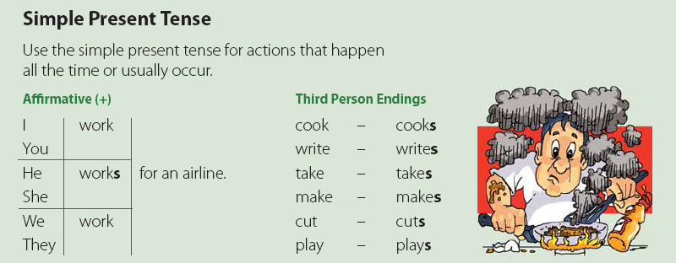
1 What Do You Do?
3 Grammar
Next
Main Page
Previous

Slide 11
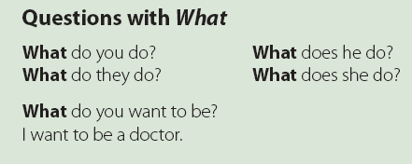
1 What Do You Do?
Next
Main Page
Previous

Slide 12
1 What Do You Do?
A. Complete the conversations. Then practice with a partner.
does
do
1. A: What ______ your uncle ______?
B: He’s a bus driver.
A: What ______ your cousin do?
B: He’s a salesperson. He works in a store. He ______ shoes.
does
sells
do
do
A: What ______ you ______?
B: I’m a reporter. I ______ for a newspaper.
A: What ______ your friends ______?
B: They’re football players. They ______ for a famous football team.
write
do
do
play
Next
Main Page
Previous

Slide 13
1 What Do You Do?
does
do
3. A: What ______ your father ______?
B: My father is a doctor. He ______ in a clinic.
A: How about your brother?
B: He ______ for a magazine.
works
works
want
to
be
4. A: What do you ______ ______ ______?
B: I want to be a teacher. What about you?
A: I ______ ______ ______ a chef and work in an elegant restaurant.
want
to
be
Next
Main Page
Previous

Slide 14
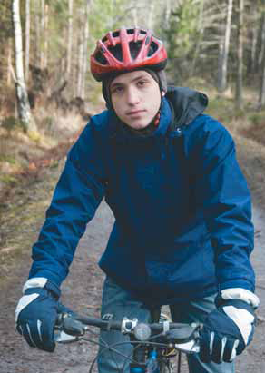
1 What Do You Do?
B. Work with a partner. Ask and answer..
A: What does Jim do?
B: He’s a cyclist. He cycles for
the national cycling team.
Next
Main Page
Previous

Slide 15
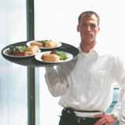
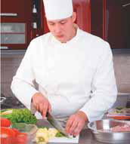
1 What Do You Do?
B. Work with a partner. Ask and answer..
1- Mike / waiter / work / restaurant
2. A: What does Mike do?
B: He’s a waiter. He works in a restaurant.
2- Hameed / cook / work / restaurant
A: What does Hameed do?
B: He’s a cook. He works in a restaurant.
Next
Main Page
Previous

Slide 16
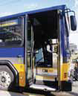
1 What Do You Do?
3- Ibrahim / cameraman / film / news
3. A: What does Ibrahim do?
B: He’s a cameraman. He films the news.
4- Mr. Smith / bus driver drive / bus
4. A: What does Mr. Smith do?
B: He’s a bus driver. He drives a bus.
Next
Main Page
Previous

Slide 17
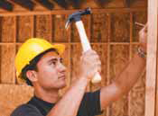
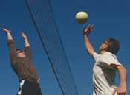
1 What Do You Do?
Fahd / carpenter / make / furniture
5. A: What does Fahd do?
B: He’s a carpenter. He makes furniture.
6- Ahmed and Raymond / volleyball players / play / volleyball team
6. A: What do Ahmed and Raymond do?
B: They’re volleyball players. They play for a volleyball team.
Next
Main Page
Previous

Slide 18
1 What Do You Do?
4 Listening
Listen to each person talk about his job. Complete the chart.
chef
restaurant
salesperson
store
teacher
school
doctor
hospital
Next
Main Page
Previous

Slide 19
1 What Do You Do?
5 Pronunciation
Listen. to the endings of the following verbs. Then practice.
/s/ /z/
Mr. Penn writes for a magazine. John sells cameras in a store.
Mr. Chang works in a bank. My father drives a bus.
Pierre cooks in a restaurant. My brother plays volleyball.
Next
Main Page
Previous

Slide 20
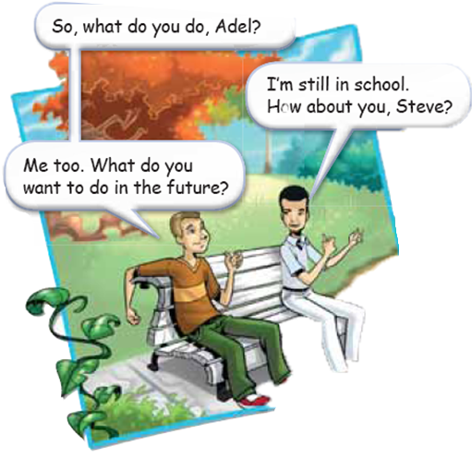
1 What Do You Do?
6 Conversation
Next
Main Page
Previous

Slide 21
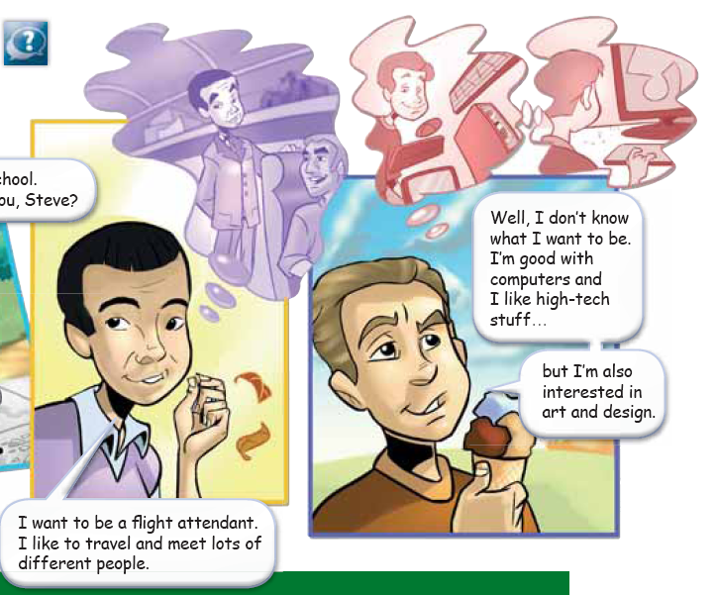
1 What Do You Do?
Next
Main Page
Previous

Slide 22
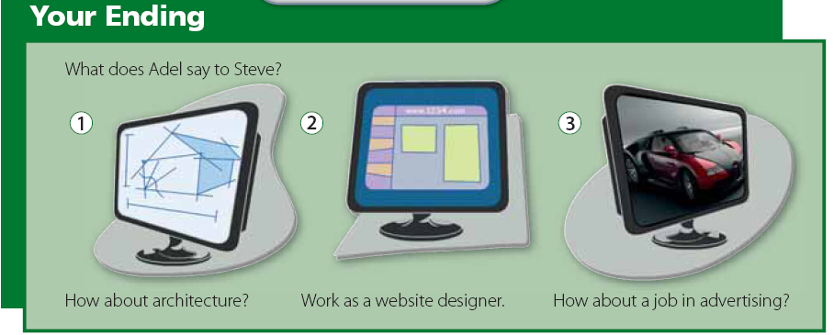
1 What Do You Do?
Next
Main Page
Previous

Slide 23
1 What Do You Do?
About the Conversation
1. What do Adel and Steve do?
2. What does Adel want to be?
3. Is it a good job for him? Why?
4. What is Steve good at?
Adel and Steve are students.
He wants to be a flight attendant.
Yes, it is. He likes to travel and meet lots of different people.
Steve is good with computers.
Next
Main Page
Previous

Slide 24
1 What Do You Do?
Your Turn
Ask your classmates what jobs their fathers or brothers do.
A: What does your brother/father do?
B: ______
Next
Main Page
Previous

Slide 25
1 What Do You Do?
7 About You
What do you want to be in the future? Discuss in a group. Say why.
Next
Main Page
Previous

Slide 26
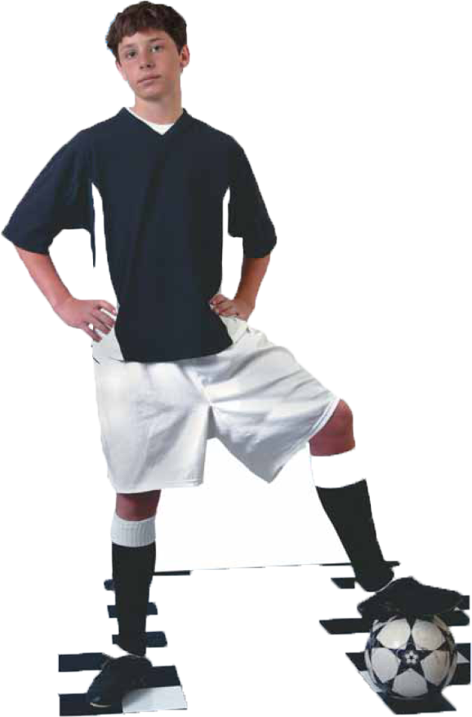
1 What Do You Do?
8 Reading
Before Reading
What do you think Omar Hamdan wants to be?
Next
Main Page
Previous

Slide 27
1 What Do You Do?
Omar Hamdan lives in Tabuk. Omar is sixteen years
old, and he’s on the school football team. Omar is
a very good player, and he’s the team’s top striker
this season.
Omar wants to be a professional football player. The coach thinks he has potential. Omar is an Al-Watani fan, and his dream is to play for Al-Watani one day. This summer Omar is going to the Al-Watani Football School. There, boys learn the techniques of football and how to work as a team. They also have a chance to meet their favorite star players.
Omar is really excited. His parents support him, but they want him to go to a university. They say: “Football is OK, but you need to think about your future. Not many people become professional players who make a lot of money. And professional football players have a very short career.” But Omar loves football, and he wants to follow his dream.
Next
Main Page
Previous

Slide 28
1 What Do You Do?
Next
Main Page
Previous

Slide 29
1 What Do You Do?
After Reading
Answer yes or no.
1. Where does Omar live?
2. Who does he play for?
3. What kind of player is he?
4. What does he want to be?
5. Where is he going in the summer?
6. What do Omar’s parents think of his plans?
Omar lives in Tabuk, Saudi Arabia.
He plays football for his school.
He’s a good player. / He’s a striker.
He wants to be a professional football player.
He is going to a football school.
His parents support him, but they want him to go to a university.
Next
Main Page
Previous

Slide 30
1 What Do You Do?
Discussion
Do you agree or disagree with Omar’s parents? Is a professional football player a good job? Is it easy to become a professional football player?
Next
Main Page
Previous

Slide 31
1 What Do You Do?
9 Writing
What’s your dream job? Write about it.
Next
Main Page
Previous

Slide 32
1 What Do You Do?
10 Project
What do you think are good and bad jobs?
Make a list and compare in a group.
Next
Main Page
Previous

