Slide 1
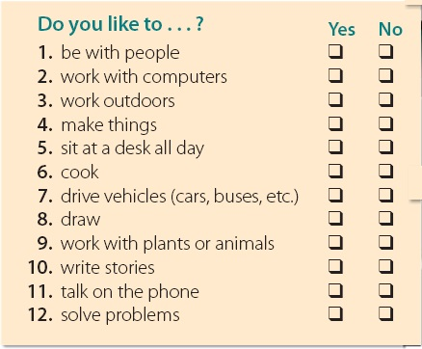
EXPANSION Units 1–4
1 Language Review
A. Answer the questions. Tick ( √ ) the boxes.
Next
Main Page
Previous

Slide 2
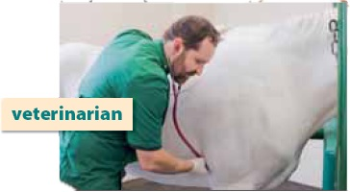
EXPANSION Units 1–4
1 Language Review
Next
Main Page
Previous

Slide 3
EXPANSION Units 1–4
B. In a group, share your answers.
What jobs are good for you?
What do other group members think?
Do they agree on a job?
Do you agree with them?
Next
Main Page
Previous

Slide 4
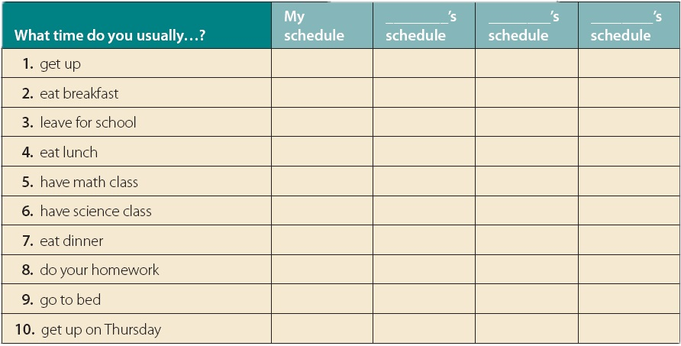
EXPANSION Units 1–4
C. Write your schedule. Then interview classmates. Whose schedule is most like yours?
Next
Main Page
Previous

Slide 5
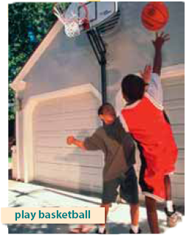
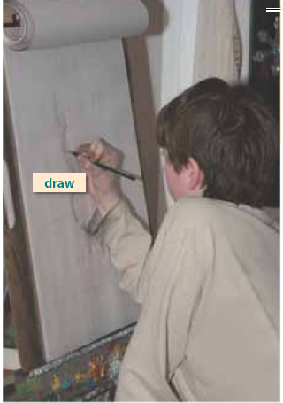
EXPANSION Units 1–4
D. Find people in your class who can do the following things. Write their names.
Next
Main Page
Previous

Slide 6
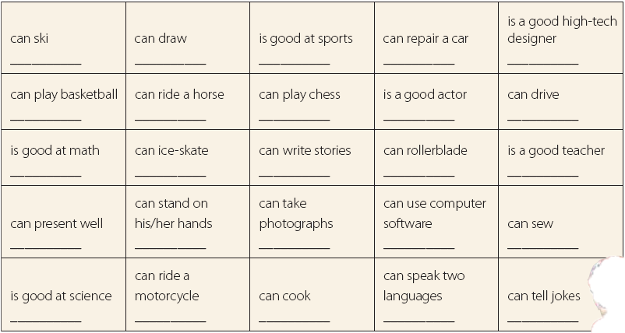
EXPANSION Units 1–4
Next
Main Page
Previous

Slide 7
EXPANSION Units 1–4
E. Choose four activities from the chart, and write how often you do them. Use always, usually, sometimes, or never.
√ I never drive a car.
1. ________________________________________
2. ________________________________________
3. ________________________________________
4. ________________________________________
Next
Main Page
Previous

Slide 8
EXPANSION Units 1–4
F . Write two activities you can do at your school and three that you can’t do.
√ can do my homework after school. OR I can’t play tennis at my school.
1. ________________________________________
2. ________________________________________
3. ________________________________________
4. ________________________________________
5. ________________________________________
Next
Main Page
Previous

Slide 9
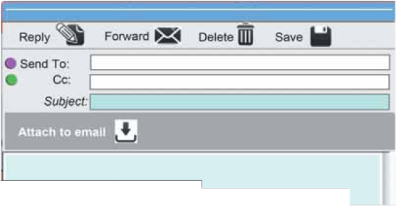
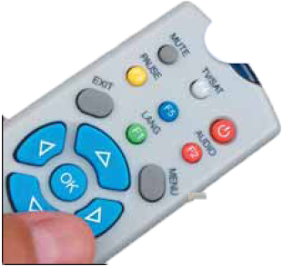
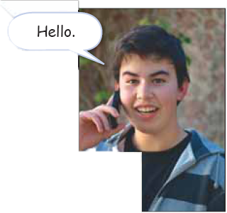
EXPANSION Units 1–4
2 Reading
Before Reading
First, look at the pictures and name the objects. Do you use the same words when you speak Arabic?
Next
Main Page
Previous

Slide 10
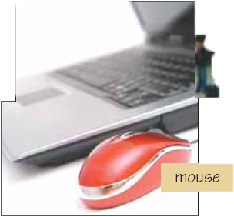
EXPANSION Units 1–4
Do you come across English in
your everyday life? Some teachers
and students complain that they
don’t use any English outside the
classroom. Think about it: we read,
hear, and use English all the time.
For example:
• Words for food like burger or
chips.
• Computer jargon that is also used in general English, such as window, mouse, click, drag, etc.
• Words for clothes like jeans or
T-shirt.
• Short greetings or abbreviations
like “Hello” or “OK.”
Next
Main Page
Previous

Slide 11
EXPANSION Units 1–4
Think of all the video games, social networks, websites, and other material on the Internet. When students search for information, they look up sources in English. Most of the films and programs on cable TV are available in English. Finally, any time you walk into a mall or a supermarket and pick up different products, check the label or the instructions. Most of the information is in English. English is everywhere, outside the classroom!
Next
Main Page
Previous

Slide 12
EXPANSION Units 1–4
After Reading
A. Read the text. Answer yes or no..
no
1. ___ Some students never use English outside the classroom.
2. ___ Some words we use for computers also have a general
English meaning.
3. ___ Students don’t need English when they search for
information on the Internet.
4. ___ Most films on cable TV are in English.
5. ___ There are no English labels on products we buy at the
supermarket.
yes
no
yes
no
Next
Main Page
Previous

Slide 13
EXPANSION Units 1–4
B. Answer the questions.
1. What is computer jargon? Find examples in the text.
2. What are some English words for food and clothes that
different speakers use?
3. When do students hear, read, or speak English?
Words and phrases that we use to talk about computers
Examples: window, mouse, click, drag, website, Internet
Food: burger, chips Clothes: jeans, T-shirt (additional examples will vary)
When they watch DVDs, when they play video games, when they use the Internet, when they watch films and programs on cable TV, when they go shopping and read labels or instructions, etc. (let students add more ideas)
Next
Main Page
Previous

Slide 14
EXPANSION Units 1–4
Discussion
1. What other English words do you use in your country?
2. What Arabic words do English speakers use?
3. Do you read the subtitles when you watch films? Why? Why not?
4. How do you feel about using English in games or on the Internet? Why?
5. Why is it important to know how to speak English?
Give examples.
Next
Main Page
Previous

Slide 15
EXPANSION Units 1–4
Writing
1. Look at the signs and write what they mean.
√ Go out this way.
2. Find and draw more signs in English, and present them to the class.
Next
Main Page
Previous

Slide 16
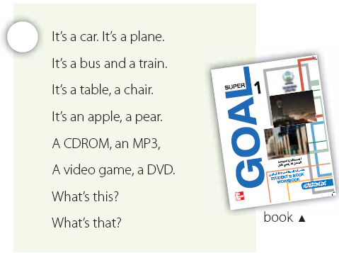
EXPANSION Units 1–4
3 Chant Along
Next
Main Page
Previous

Slide 17
EXPANSION Units 1–4
Next
Main Page
Previous

Slide 18
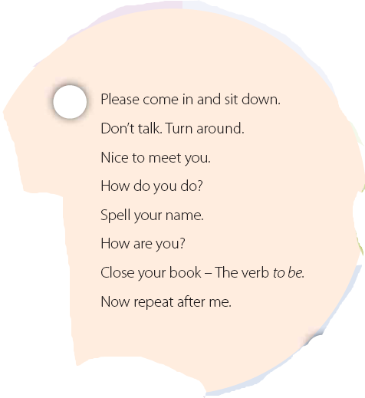
EXPANSION Units 1–4
Next
Main Page
Previous

Slide 19
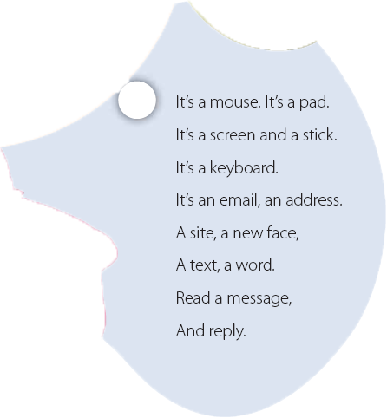
EXPANSION Units 1–4
Next
Main Page
Previous

Slide 20
EXPANSION Units 1–4
Vocabulary
A. Match the two parts. Write the number in the blank.
1. “Repeat after me” a. ___ when we meet someone for the first time.
2. We say “How are you?” b. ___ to move on the screen and click.
3. We say “How do you do?” c. ___ is something the teacher says.
4. We reply d. ___ when we meet a friend.
5. We use the mouse e. ___ when we write an answer to an email.
c
d
a
e
b
Next
Main Page
Previous

Slide 21
EXPANSION Units 1–4
B. Put the words into the correct groups.
Next
Main Page
Previous

Slide 22
EXPANSION Units 1–4
Technology | Transportation | Classroom
pen
bus
DVD
book
car
CDROM
pencil
train
mouse
paper
plane
keyboard
chair
bike
email
partner
motorcycle
video game
Next
Main Page
Previous

Slide 23
EXPANSION Units 1–4
Comprehension
Answer yes or no.
1. ___ A circle has 4 sides.
2. ___ When you spell your name, you need to say each letter separately
3. ___ We put a pad under the keyboard.
4. ___ We click with the mouse.
5. ___ There are sites on the Internet.
no
yes
no
yes
yes
Next
Main Page
Previous

Slide 24
EXPANSION Units 1–4
4 Project
1. Keep a record of what you do in English each day. Think about what you hear, read, and see.
2. Compare with a partner.
3. Do a class survey. Find out how much English your classmates use.11
Next
Main Page
Previous

