Slide 1
Unit : 3
What is
that?
Grammar
Presented by
Waleed Al Sqour
www.saudienglish.net

Slide 2
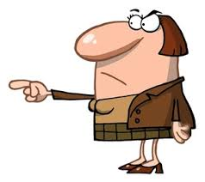
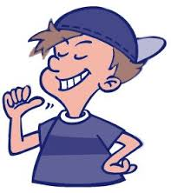
Demonstrative Pronouns
Singular
This , that
Plural
These , those
Use this/these for things near you.
Use that/those for things far from you.

Slide 3
This is a pen.
That is a book.
These are pencils.
Those are books.

Slide 4
Is this a pen?
Is that a book?
Are these pencils?
Are those books?

Slide 5
What is this?
What is that?
What are these?
What are those?

Slide 6
Imperatives
Affirmative
affirmative imperative begins
with the verb.
Sit down.
Please sit down.
Negative
negative imperative begins with Don’t
Don’t sit down.
Please don’t sit down.
Please makes the command more polite.

Slide 7
Indefinite Articles: a / an
a
It comes before singular nouns.
Use a before words that begin with a consonant sound:
a radio, a calculator, a painting.
an
It comes before singular nouns.
Use an before words that begin with a vowel sound:
an airplane, an ink, an ice
The vowels are a, e, i, o, u.

