Slide 1
Unit : 2
What Day
Is Today?
Grammar
Presented by
Waleed Al Sqour
www.saudienglish.net

Slide 2
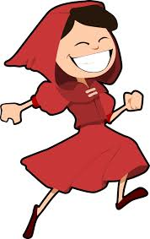
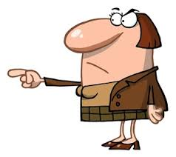
Possessive Adjective
Singular
my, your,his, her
Plural
our, your, their

Slide 3
My name is Waleed.
His name is John.
Her name is Mona?
Our vacation is in May.
Your vacation is in May.
Their vacation is in June.

Slide 4
Question words: what, when, how old
Read the following questions & answers;
A:What day is today?
B:It’s Sunday.
A:What is the date tomorrow?
B:It’s January 20th.
A:How old are you?
B:I’m fifteen.

Slide 5
Question words: what, when, how old
Now
Which question word asks about time?
Which question word asks about age?

Slide 6
Question words: what, when, how old
Answers
Which question word asks about time?
(when)
Which question word asks about age?
(how old)

Slide 7
Preposition ( in / on ) with date
We use in with months
The final test is in September.
In England, it often snows in December.
Do you think we will go to Jupiter in the future?
There should be a lot of progress in the next century.
We use on with date/days
The final test is on 21st.
The final test is on sat.
Do you work on Mondays?
Her birthday is on 20 November.
Where will you be on New Year's Day?

Slide 8
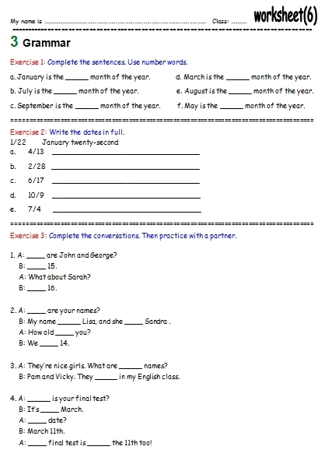
Now,
With your partner
Do the worksheet
No.6

