Slide 1
Unit : 1
Good
Morning !
Grammar
Presented by
Waleed Al Sqour
www.saudienglish.net

Slide 2
Verb to be
Is - are - am
Notes:
Give student 5 Minute for answers

Slide 3
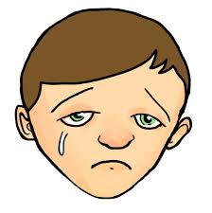
affirmative
I am happy
He is sad
They are friends
She is Asma
Notes:
Give student 5 Minute for answers

Slide 4
negative
I am not happy
He is not sad
They are not friends
She is not Asma
Notes:
Give student 5 Minute for answers

Slide 5
Yes / no questions
Am I happy?
Is he sad?
Are they friends?
Is she Asma?
No, you are not.
Yes, he is.
No, they are not.
Yes, she is.
Notes:
Give student 5 Minute for answers

Slide 6
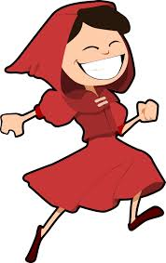
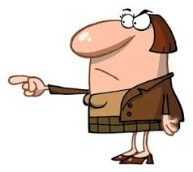
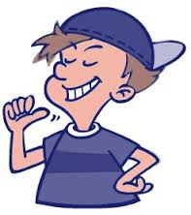
Possessive Adjective
Singular
my, your,his, her
Plural
our, your, their

Slide 7
My name is Waleed.
His name is John.
Her name is Mona?
Our vacation is in May.
Your vacation is in May.
Their vacation is in June.

Slide 8
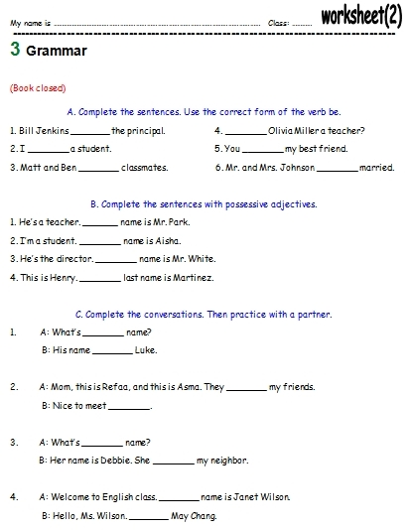
Now,
With your partner
Do the worksheet
No.2

