Slide 1
Module 2 “ Beyond Limits”

Slide 2
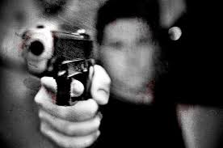
Crime and Punishment

Slide 4
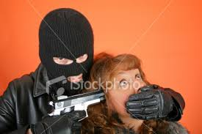
kidnapping

Slide 5
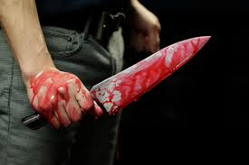
murder

Slide 6
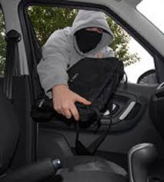
theft

Slide 7
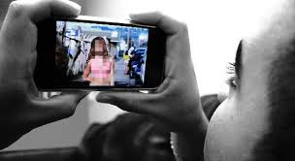
blackmail

Slide 8
fraud

Slide 9
forgery

Slide 10
hacking

Slide 11
blackmail
kidnapping
forgery
fraud
murder
theft
hacking

Slide 12
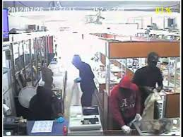
What did the two men need ?
A
What did they think their best bet would be ?
Why did the two men feel nervous ?

Slide 13
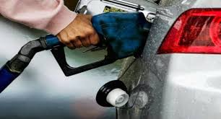
Where did the man decide to steal petrol from ? How ?
B
What did the police later find?

Slide 14
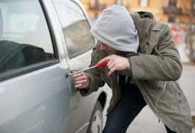
Why did Daniel place an ad in the paper ?
C
Why did he have to call the police ?
What did he leave in the car?

Slide 15
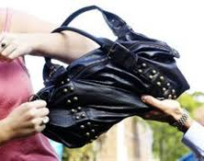
What did the man seize from the woman ?
D
How did the police arrest the suspect ?
Did the suspect understand the police ?

Slide 16
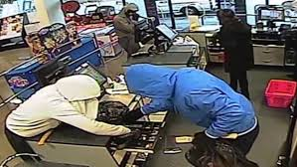
What did the man notice while he was waiting ?
E
What did he leave ?

Slide 17
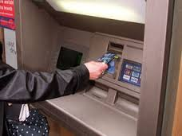
Who did the man kidnap? How ?
F
What did he do in the cashpoints ?

