Slide 1
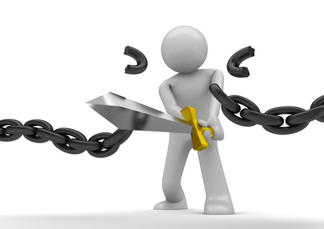
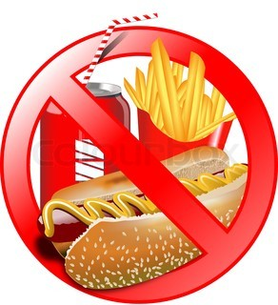
Unit:6
reading
Breaking the habit-getting healthy

Slide 2
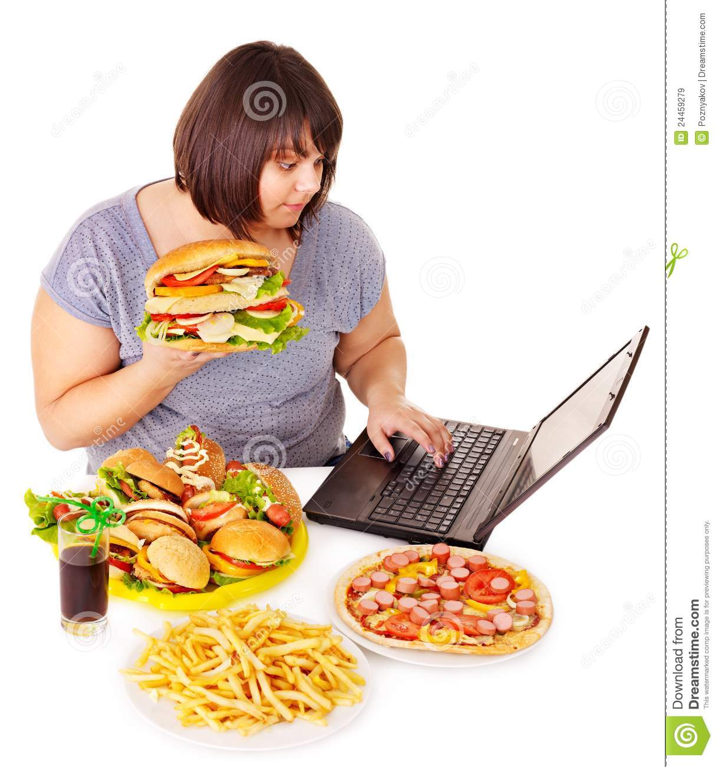
what you think are the main ingredients that attract people to junk food. Share your answers
with the class.

Slide 3
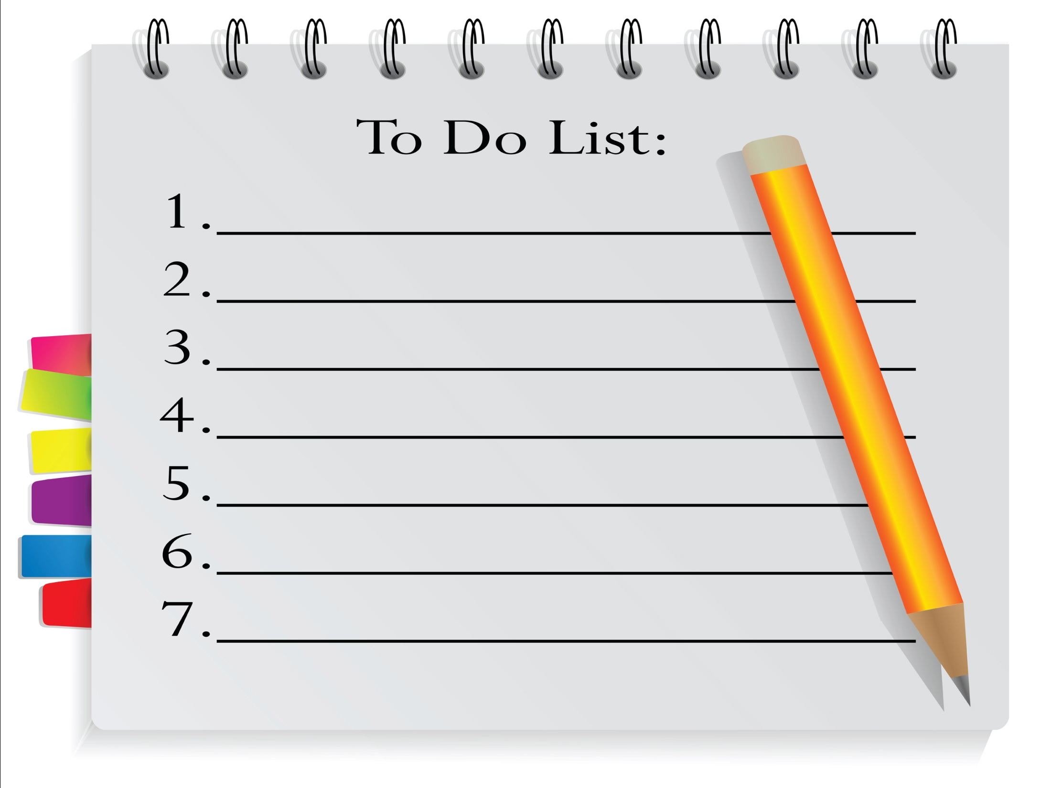
The following is a checklist to help you decide
if it’s time for you or a friend to change eating
habits. Just ONE “warning sign” should
Be enough reason to take action.

Slide 4
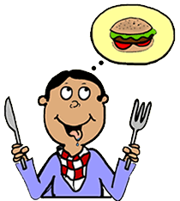
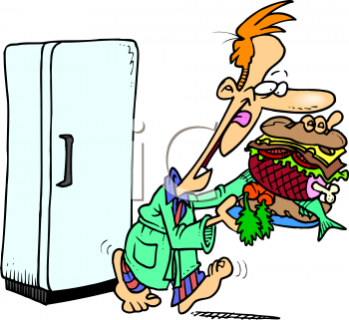
􀀗 You shouldn’t think ‘junk food’ the minute you start feeling
hungry. There never is an acceptable reason for this. It is a definite sign of a habit that is on the way to becoming an addiction
.

Slide 5
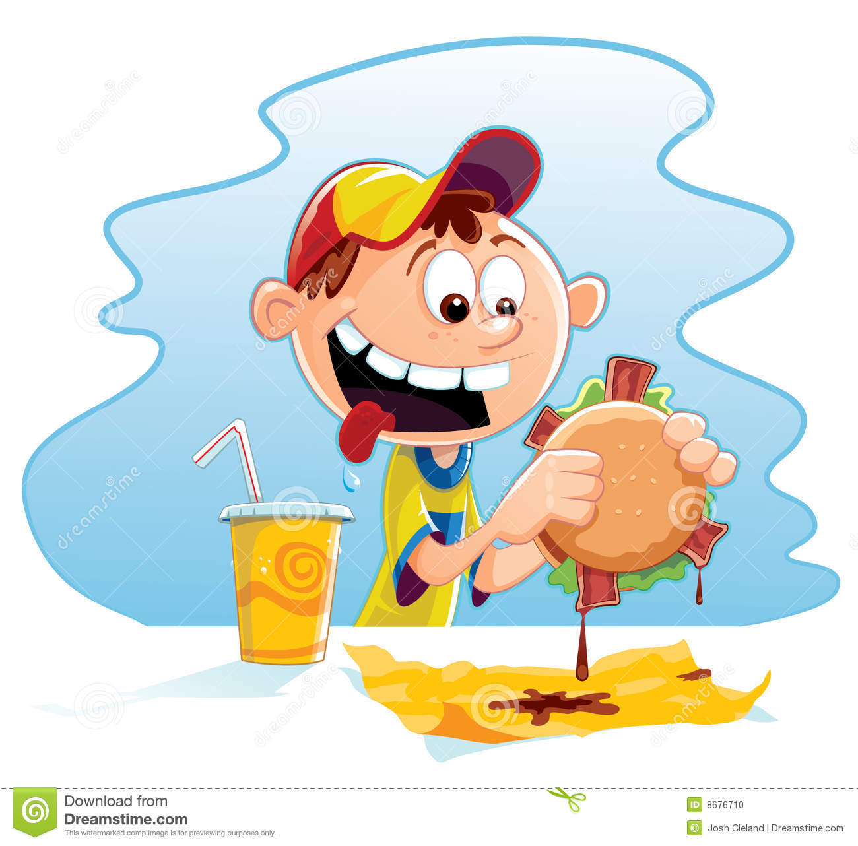
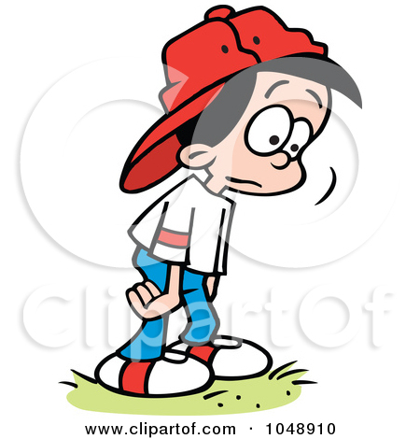
Comfort eating is usually associated with junk food and in general
high calorie food that is also high in carbohydrates [starch and sugar] and saturated fat. If you run to the nearest fast food chain every time you feel down, you know it is out of control.

Slide 6
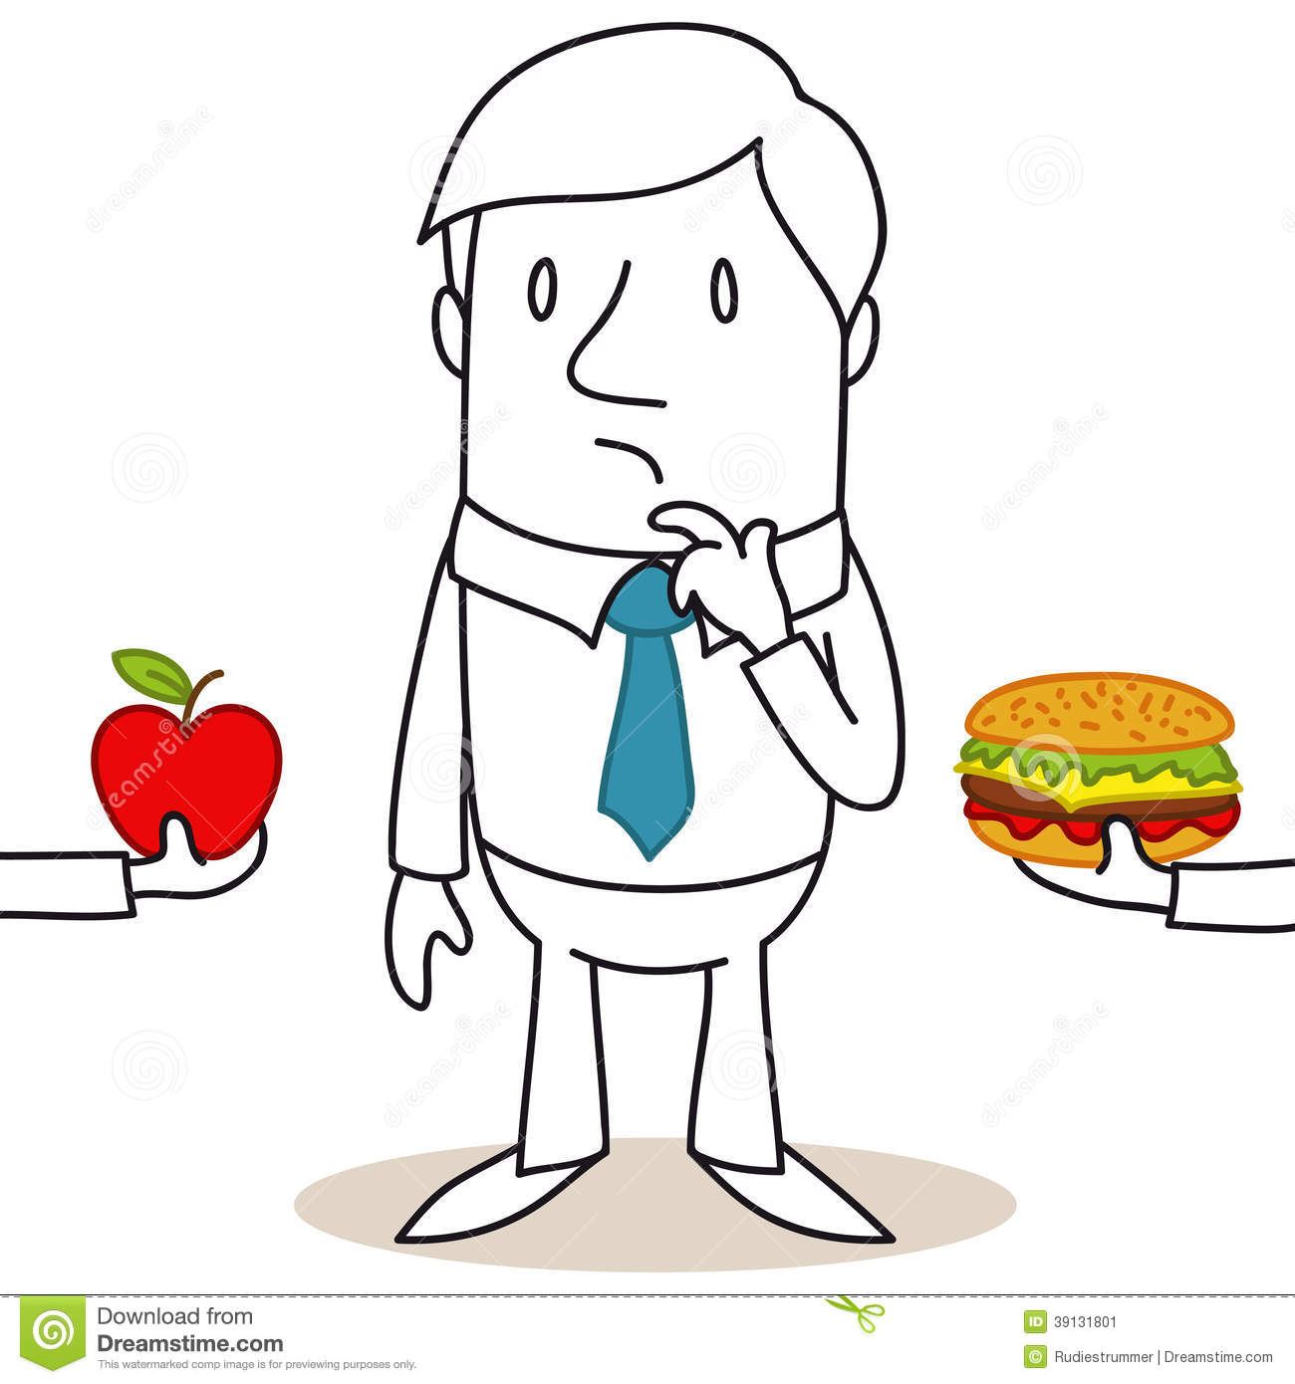
A healthy, nutritious meal does not have to be bland and boring. When pushed you can picture appetizing dishes that do not contain fries or fatty ingredients but you still prefer to get a hold of a beef burger or a pizza. You know it’s not the best food for you. You know that you are going to feel sleepy and tired after you have eaten.

Slide 7
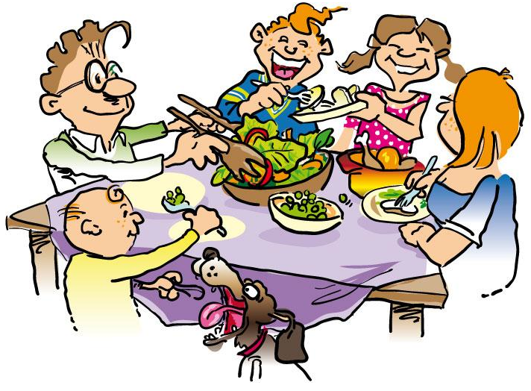
To be honest, healthy is a relative term. It all depends on what your alternatives are. There are ‘healthier’ choices you can make even at a fast food restaurant. You might, for example, order salad
as a side dish instead of a second helping of fries. You could avoid condiments such as ketchup or mayonnaise or eat a chicken burger. You know all this, you have promised yourself to do it next
time you are there, but somehow it never happens. You keep on insisting that those dishes take longer to prepare.

Slide 8
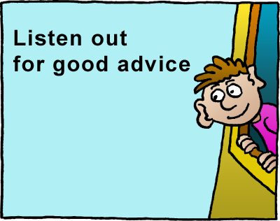
To break a habit
you should!!.....

Slide 9
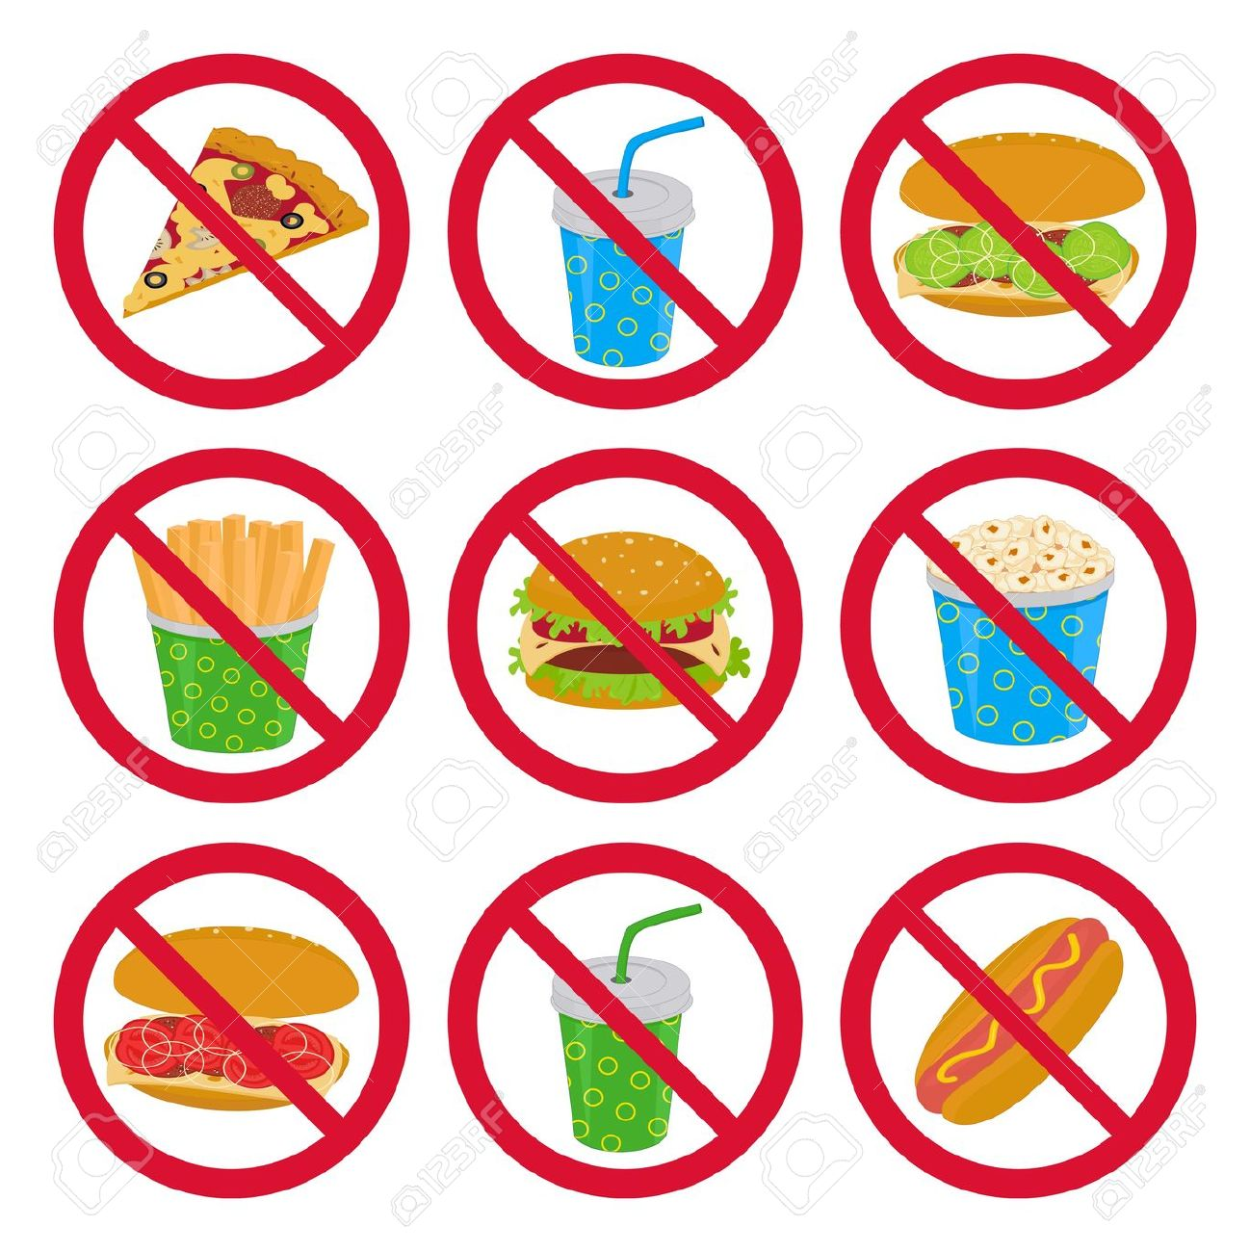
• You ought to decide on your own if it’s best to cut down on the amount of junk food you eat, gradually over a period of time, or whether it’s best to stop altogether for some time.
• You should allow yourself some time to do it successfully
• You shouldn’t give up simply because you were with friends and joined them for dinner at a fast food restaurant, or because you helped yourself to a few fries.

Slide 10
• Pick up some menus from different restaurants and read
them carefully, paying attention to the ingredients of each
dish.
• You might go to the supermarket and wander around
making a list of all the food and ingredients that you find
attractive.
• If a friend insists on offering you junk food, turn down the
offer and treat yourself to something nice.
• Make a list of all the things you enjoy doing but had to give
up because you gained weight or do not feel energetic
enough.

Slide 11
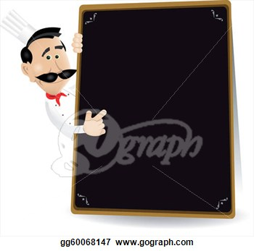
After Reading
Answer true or false according to the information in the reading.
1. ___ Eating habits affect the way one’s brain operates.
2. ___ Associating hunger with fast food is a sign of addiction.
3. ___ Comfort eating is associated with healthy food.
4. ___ If you cannot stop eating junk food immediately, there is no hope of ever breaking the habit

Slide 12
Prepared by
Miss Sara

